Slide 1
­­Hillcrest Elder Selection
­­Lesson 4 (Details of the selection process)

Slide 2
­­Hillcrest Elder Selection
­­Lesson 4 (Details of the selection process)
Main Objectives:
To communicate the Hillcrest Elder selection process with a focus on timing and key steps as we serve together in our spiritual house.
To share the importance of participating in the Eldership selection by encouraging the congregation to identify men who will serve well
To familiarize the congregation with how to access the beliefs document (expanded version) posted on the Hillcrest website and the Hillcrest policy manual.
(Brief History) - Details of selection process
For many years, elder selection at Hillcrest has been a simple process. Men were nominated by the congregation. A discernment line was determined. All men receiving enough nominations to place them above the discernment line, and that were willing to serve, were submitted to the congregation for affirmation (assuming there were no unresolved scriptural objections). Also, those that were affirmed, served until they retired or died. A change to this process occurred in the early 2000’s.

Slide 3
­­Hillcrest Elder Selection
­­Lesson 4 (Details of the selection process)
Several Important Aspects of the Selection Process included (Guiding Principles):
1) The current eldership completely removed themselves from the process to avoid any appearance of influencing the outcome,
2) A committee was selected through the bible classes and they oversaw the process,
3) Confidentiality in who members nominated, registered scriptural objections against, and affirmed or withheld affirmation;
4) Each nominee, including existing elders, were expected to fill out a nominee questionnaire.
There have been minor edits to the process, but for the most part there isn’t much change.
For the 2025 selection time, there will be one change. The change will be that All current elders seeking to continue in the role as an elder will be renewed for an additional term without participating in the affirmation process. This gives us the opportunity to focus on the men identified for potential eldership, at this time.
The elder selection process involves prayer and seeking the guidance of the Holy Spirit in all we do.

Slide 4
­­Hillcrest Elder Selection
­­Lesson 4 (Details of the selection process)
The Nomination Stage
This is Today!
Jan. 26 Nomination Forms due by 12:00 noon.
Jan. 26-28 Committee to tally nominations
Jan. 29 Committee presents a blind list of all nominees to the elders sorted from highest to lowest number of nominations. Elders will determine, without knowing nominee names, which nominees received an adequate number of nominations to move forward in the process.
Jan. 30-Feb. 1 Nominees receiving an adequate number of nominations to be informed by committee members (2 each) to determine who wishes to move forward.
Feb. 2 Nominees are given Nominee Information Forms and meet with current elders and committee members to discuss responsibilities and commitment of eldership.

Slide 5
­­Hillcrest Elder Selection
­­Lesson 4 (Details of the selection process)
The Self-Examination Stage
Feb. 11 Nominee Information Forms due to committee by 5:00 p.m..
Feb. 16 Present Nominees to congregation and call for scriptural objections
The Congregational Examination Stage
Feb 17. Nominee Information Forms available to congregation until March 30 via www.hillcrestonline.com website.
The Scriptural Objection Stage
March 2 Period for scriptural objections ends at 5:00 p.m., candidates are determined

Slide 6
­­Hillcrest Elder Selection
­­Lesson 4 (Details of the selection process)
The Candidate Stage
March 16 Elder Selection Forms distributed via email. Paper forms will also be available during morning assembly. Each member is to vote on each candidate stating either 1) yes, I am willing to serve under the candidate’s leadership; 2) no, I prefer not to serve under the candidate’s leadership, or 3) I don’t know the candidate well enough to respond.
March 17 Paper Elder Selection Forms available in auditorium on Sundays and church office (office hours).
March 30 Last day to submit Elder Selection Forms by 12:00 noon
March 30-31 Tabulation of nominees by 3rd party
April 1 3rd Party presents a blind list of all nominees showing their respective percentage of members who find them acceptable (using only the Yes and No votes), and the percentage of members who know the elder candidate (using all votes). Committee determines what the appropriate threshold percentages should be and which anonymous candidates will be considered called out by the congregation.
April 6 Announce additional elders to congregation
April 13 Confirm additional elders in morning assembly followed by all church luncheon

Slide 7
­­Hillcrest Elder Selection
­­Lesson 4 (Details of the selection process)
Scriptural Objection
We have redistributed the class handout from Lesson 2 entitled Qualities of the Biblical Elder. We encourage all members to prayerfully review and consider this handout, and meet with the candidate you have concerns about, prior to submitting a scriptural objection to the committee for consideration.
Note: Every member will received an email with a link to the Belief Statement and Policy Manual that each candidate agrees to support if he is affirmed by the congregation. (reference class handout)
Shaped by Scripture: Our hope is to be simply Christians in Christ’s church.
Listed on the following slides are some of the key areas and scriptures covered in the “Shaped by Scripture” section of “What we Believe”.

Slide 8
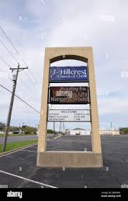
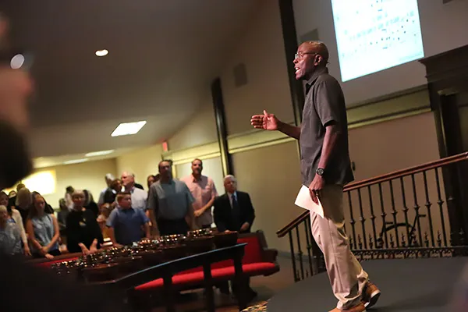
­­Hillcrest Elder Selection
­­Lesson 4 (Details of the selection process)
Understands God’s Relationship to Christ Jesus
God is the Creator and Ruler of the universe. He has eternally existed in three persons: the Father, the Son, and the Holy Spirit. The three are co-equal in nature and are one God.
Genesis 1:1, 26-27; 3:22, Psalm 90:2, Matthew 28:19, I Corinthians 8:6, 1 Peter 1:2
Only through Jesus will we find the way to have a relationship with our Creator, the truth concerning reality, and spiritual life both now and in eternity.
John 14:6, Acts 4:12
The items covered on the next three slides include a partial listing of the Hillcrest Belief Statement (Shaped by Scripture areas). It is recommended that all members review the Hillcrest info “What We Believe”. All elders agree to support these beliefs!

Slide 9
­­Hillcrest Elder Selection
­­Lesson 4 (Details of the selection process)
Being in a Relationship with God through Jesus
We are the supreme object of God’s creation. We are made in the spiritual image of God, to be like Him in character while exercising free moral choice. Unfortunately, we have chosen to sin and thus have become separated from God. This is the dangerous condition from which we must be saved.
Genesis 1:27, 9:6, Psalm 8:3-6, Isaiah 53:6a, Romans 3:23, Isaiah 59:1-2
Faith culminates in baptism of the penitent believer. Baptism (immersion) is a reenactment of the death, burial, and resurrection of Jesus. Baptism is the time at which God pronounces forgiveness and where our guilt of sin is removed. We recognize that baptism is essential for salvation.
Matthew 3:16, Matthew 28:19-20, John 3:3-5, Acts 2:38, Acts 8:36-39, Acts 22:16, Romans 6:1-14, 1 Peter 3:21, Ephesians 1:5

Slide 10
­­Hillcrest Elder Selection
­­Lesson 4 (Details of the selection process)
Being in a Relationship with God through Kingdom Community
The church is not a sacred building, but a gathering of God’s people. It is composed of all who have experienced the new birth (baptism) through faith in Jesus. Each new Christian, at the moment of salvation, is added by the Lord to His one universal church. Jesus is the only head of His church. His church finds expression in local congregations with each having its own leadership of elders.
Acts 2:41-47, Acts 20:28, I Corinthians 1:2, Ephesians 5:23-32, Titus 1:5
The Bible leads us to understand that we all have important roles within His family. God asks men to fill some roles while asking women to fill others. We trust God’s infinite wisdom concerning our roles in our homes, in church leadership and in assembly worship.
Genesis 1, Genesis 2, Genesis 3, Galatians 3:26-29, 1 Corinthians 11:3, 1 Corinthians 14:33-35, Ephesians 5:25-33, 1 Timothy 2:11-15, 1 Timothy 3: 1-2, 1 Timothy 3:12

Slide 11
­­Hillcrest Elder Selection
­­Lesson 4 (Details of the selection process)
Class Activity
Have you submitted names for the eldership role.

