Slide 1
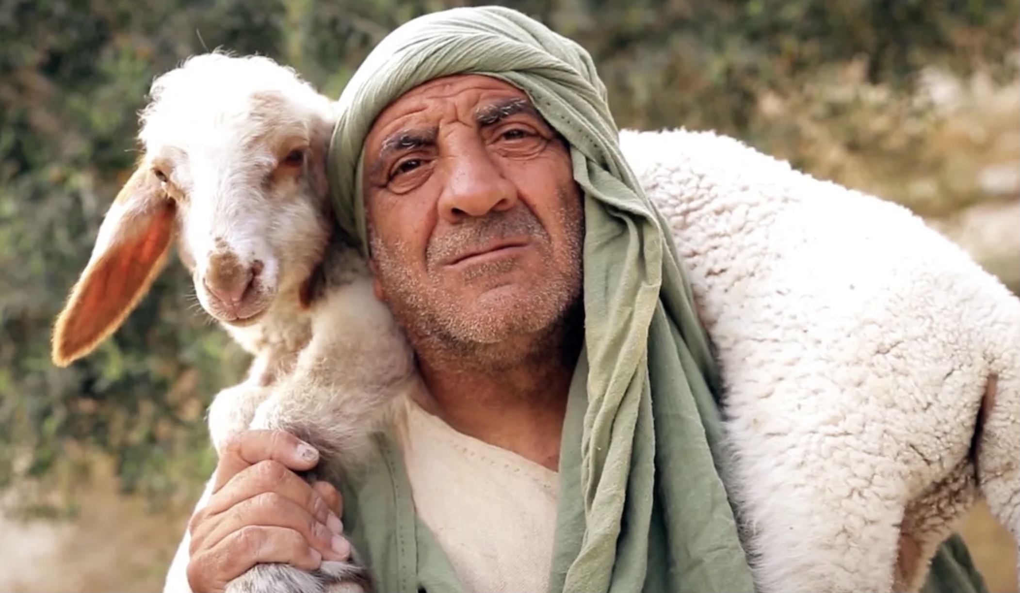
Words used for Role and Function of New Testament Leaders Elder—Shepherd—Overseer—Steward

Slide 2
Words used for Role and Function of New Testament Leaders
For this reason I left you in Crete, that you might set in order what remains, and appoint elders in every city as I directed you, 6namely, if any man be above reproach, the husband of one wife, having children who believe, not accused of dissipation or rebellion. 7also the overseer must be above reproach as God’s steward, not self-willed, not quick-tempered, not addicted to wine, not pugnacious, not fond of sordid gain, 8but hospitable, loving what is good, sensible, just, devout, self-controlled, 9holding fast the faithful word which is in accordance with the teaching, that he may be able both to exhort in sound doctrine and to refute those who contradict. Titus 1:5-9
Therefore, I exhort the elders among you, as your fellow elder and witness of the sufferings of Christ, and a partaker also of the glory that is to be revealed, 2shepherd the flock of God among you, exercising oversight not under compulsion, but voluntarily, according to the will of God; and not for sordid gain, but with eagerness; 3nor yet as lording it over those allotted to your charge, but proving to be examples to the flock. 1 Peter 5:1-3
And from Miletus he sent to Ephesus and called to him the elders of the church… 28Be on guard for yourselves and for all the flock, among which the Holy Spirit has made you overseers, to shepherd the church of God which He purchased with His own blood. Acts 20:17, 28

Slide 3
Words used for Role and Function of New Testament Leaders
Title | Equivalent | Implications | Scriptures
Elder | Presbyter | One that displays wisdom and maturity in the community of believers | Titus 1:5 James 5:14
Shepherd | Pastor | One who feeds and protects the flock | Ephesians 4:11 Acts 20:28
Overseer | Bishop | A supervisor that oversees the congregational needs | Philippians 1:1 1 Timothy 3:2
Steward | Manager | A trustee or manager serving in God’s household | Titus 1:7 1 Corinthians 4:2

