Slide 1

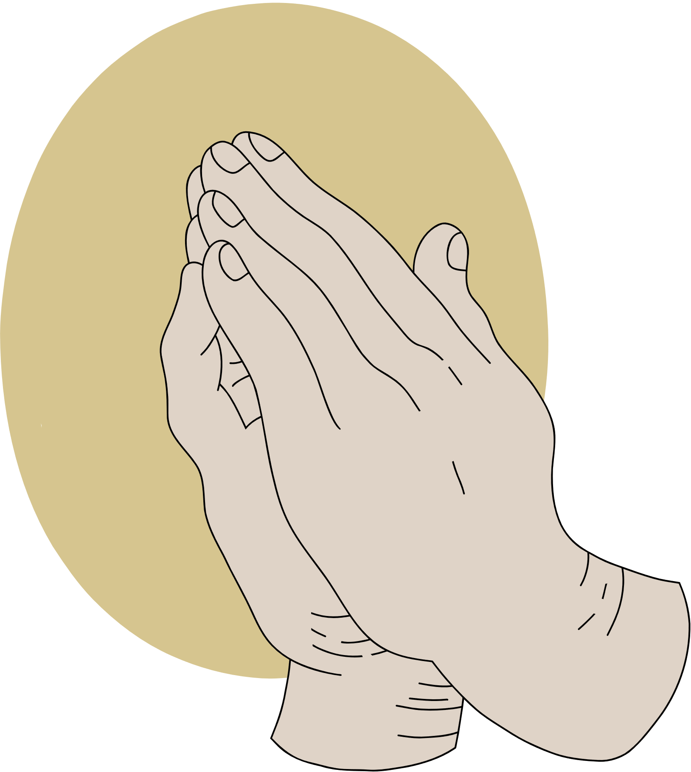
JOY
AMID TRIALS
A study of Philippians

Slide 2
ANNOUNCEMENTS

Slide 3

NO CONFIDENCE IN THE FLESH
SCRIPTURE

Slide 4


REFLECT
  Read Philippians 3: 1-11 and focus on the following words:
Rejoice, Watch-Out, Flesh, Confidence, Gain, Loss, Faith, Power, and Resurrection
  Reflect on these words as the scriptures are read and how they relate and contrast within Paul’s message. Consider which Word or Words speak to you the most.

Slide 5



READ
Philippians 3: 1-11
Rejoice, Watch-Out, Flesh, Confidence, Gain, Loss, Faith, Power, and Resurrection

Slide 6
Rejoice and celebrate in the Lord!
REJOICE

Slide 7

PHIL. 3:1-2
  How do we rejoice in the Lord when we face trials and know there are those who want to do us wrong? (James 1:2)
  What is required for us to stay safe?
  Who are those we need to watch out for?

Slide 8
No Confidence in the Flesh (What we have done or accomplished)
HUMILITY

Slide 9
PHIL. 3:3-6
  What is the point Paul is making in verses
  3 through 6?
  How can we be proud of what we have accomplished and yet not give too much credit to ourselves?

Slide 10
Our gains in Christ surpass everything we consider loss because of our faith in Christ
FAITH

Slide 11
PHIL. 3:7-9
  Why is it so hard to put our “faith in Christ Jesus” first in our lives?
  What does this require from both a personal choice and sacrifice to fully gain Christ?

Slide 12
Knowing Christ includes becoming like him in his death and attaining the resurrection
KNOWING

Slide 13
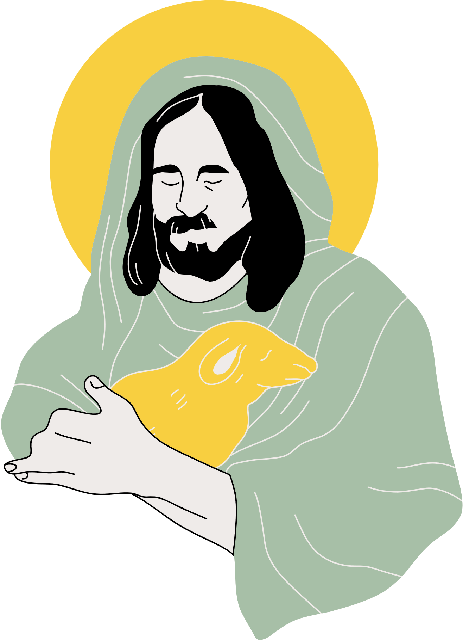
OUR EXAMPLE
As our lesson started, “Our confidence is not in “who” we are but in “whose” we are!” This should be reflected in what we say and what we do! It is so important we never lose sight of this point!

