Slide 1

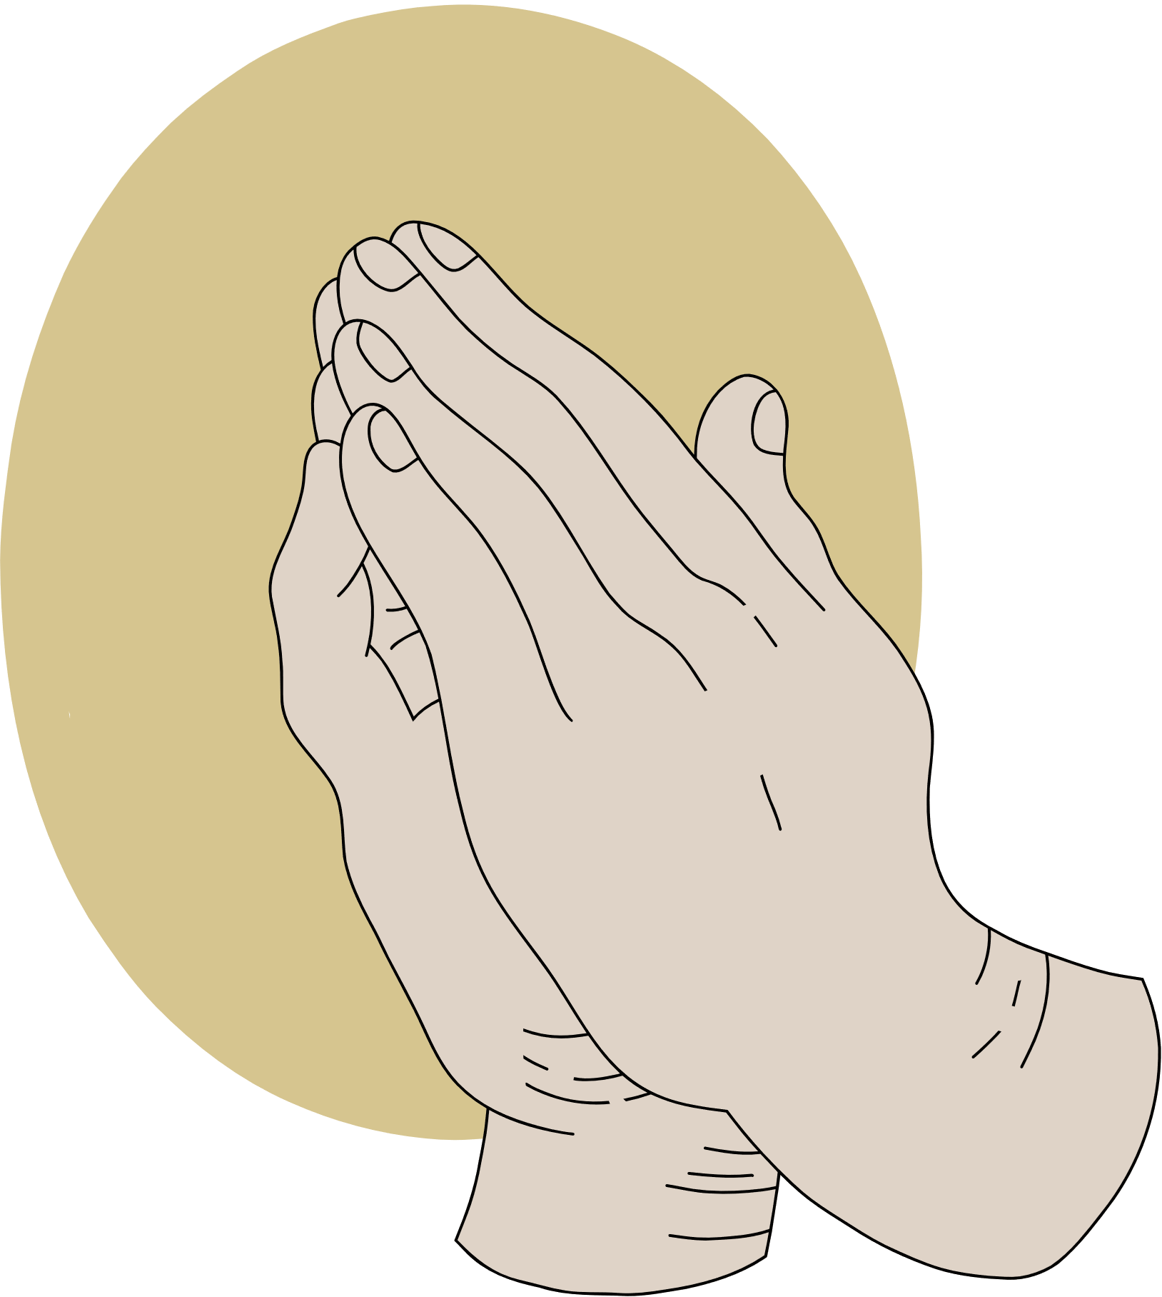
JOY
AMID TRIALS
A study of Philippians

Slide 2
ANNOUNCEMENTS

Slide 3


REFLECT
How many of your posts could be considered complaining?
How many times did you complain about a fellow coworker?
Or about your daily chores?
Now, mentally compare that number to the number of times you posted, discussed, or messaged about Jesus. It’s easy to get sucked into the “complain game”, so today we’re focusing on how to combat that, so we can “shine as stars”.

Slide 4

Do we work for a free gift?
WORK OUT

Slide 5



READ ALOUD
to answer: Do we work for a free gift?
01
02
03
Philippians 2:12-13
James 2:14, 17-20, 26
Romans
6:23

Slide 6

LET’S CONSIDER
In light of these verses, what does it mean to "work out your (plural) salvation"? What part is God's and what part is ours?

Slide 7



DISCUSS
With the person on your right discuss: What does it mean to "work out your (plural) salvation"? What part is God's and what part is ours?

Slide 8
How do we “shine like stars”?
BIASES

Slide 9
READ
Class leader, read Philippians 2:13-18, 2:1-4

Slide 10

NEGATIVITY BIAS
Dr. Rick Hanson, a published psychologist, has studied our brain’s negative bias. His studies have shown that as a species we naturally dwell on the negative, and have to be incredibly intentional about rooting and dwelling on the positive.

Slide 11


FROM 5:11-8:20MINS.

Slide 12

ENGAGE
Mentally or actually write down 3 things that you are grateful for that happened today.
Next, get out their phones and set an Attitude of Gratitude reminder to go off daily and continue the practice.
    If you want a deeper challenge, you can list 3 things you’re grateful that you learned from your most recent trials.

Slide 13
Who is your “Timothy and Epaphroditus”?
MENTORS

Slide 14
READ
Silently read Philippians 2:19-30, and as you read, think about people you know personally who have similar characteristics.

Slide 15

ACTIVITY
  Write a thank you note to your “Timothy and Epaphroditus”, spiritual encouragers.
  Deliver/mail the letter to them this week.
  If you can’t think of someone specific, you can write a letter to someone asking them to be their mentor or to one of the faith-based organizations, or ministry partners of Hillcrest.

Slide 16
IMAGINE THIS...

Slide 17
APPLY
Take a moment each day to take a few deep breaths and have an attitude of gratitude.

Slide 18
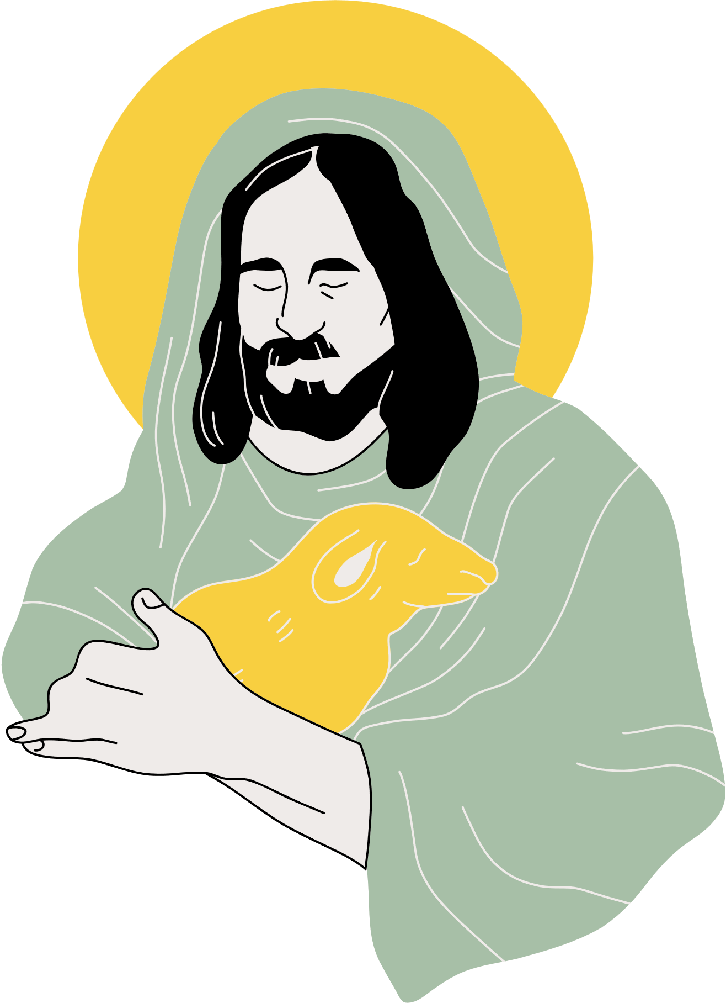
WRAP UP
Today we reflected on our negative mental bias and how scripture-focused gratitude can help us combat that. Next week, we will examine how gratitude and humility coexist.

