Slide 1

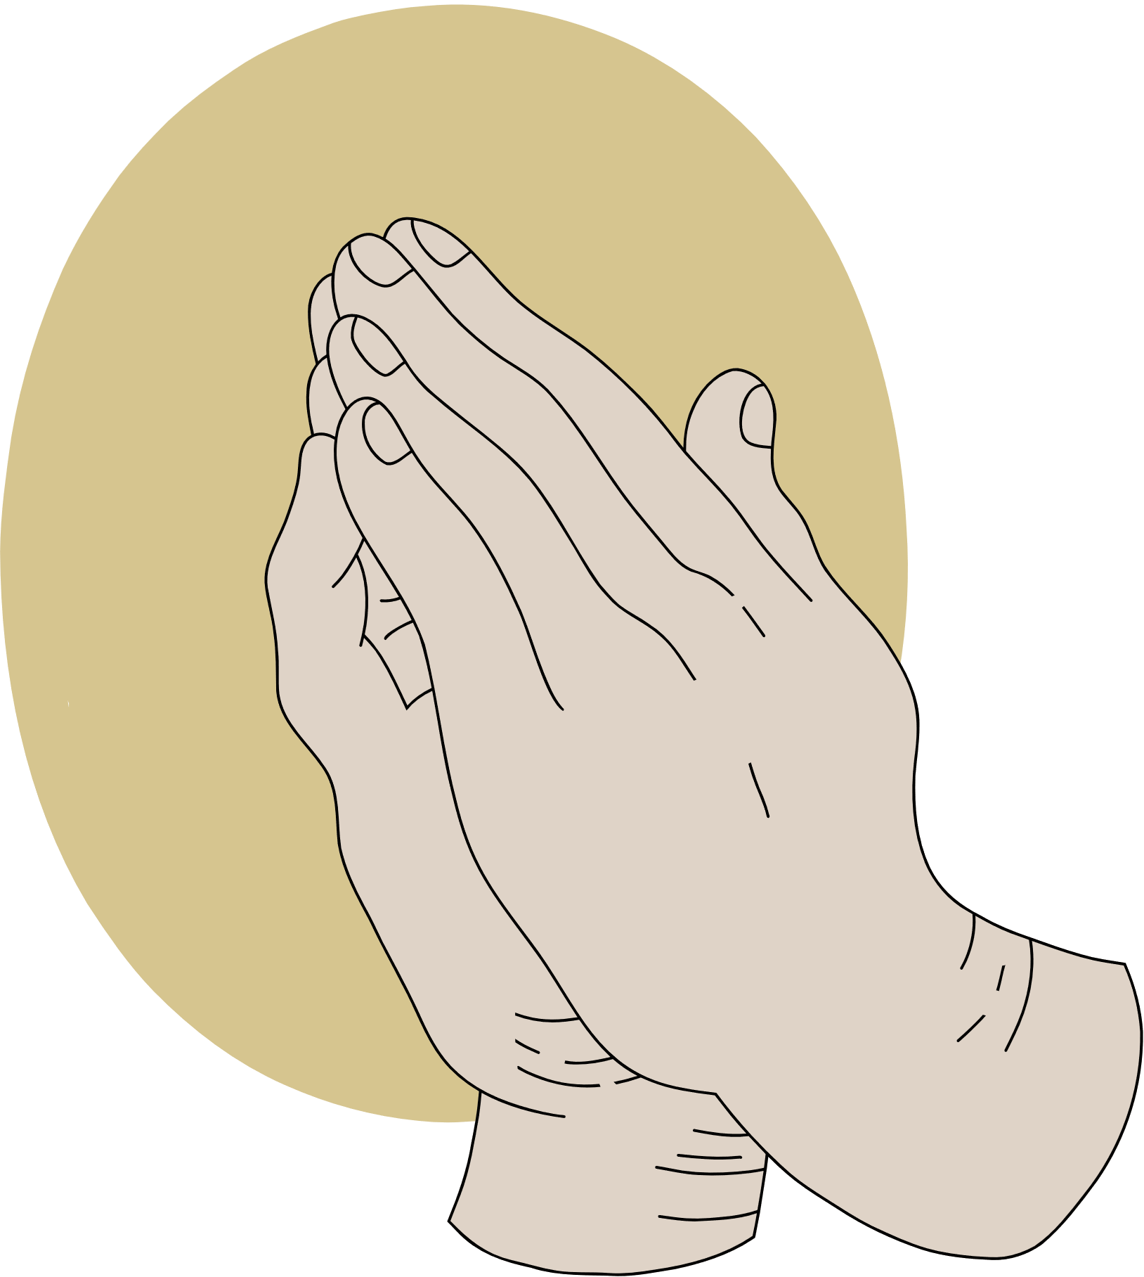
JOY
AMID TRIALS
A study of Philippians

Slide 2
ANNOUNCEMENTS

Slide 3


REFLECT
  Can you think of someone who exhibits humility by the way they lead their life? In what ways do they show humility?
  Thinking of how we learn humility – Is it something learned from society, or learned from the example of Christ?

Slide 4

What is humility?
SCRIPTURE

Slide 5



READ
Read aloud
Philippians 2: 1-11

Slide 6

LET’S CONSIDER
...the teaching practiced by members of the Philippians church

Slide 7

LEARN
In verses 1-2 Paul ‘s joy for the Philippian church and their fellowship with the Holy Spirit included:
  Being like-minded – really involving one’s heart, mind, feelings, attitudes, and will, not just saying “we are united.”
  Having the same love
  Being one in spirit and purpose

Slide 8

LEARN
Paul encouraged the Philippian church to have a Christ-like attitude, which included: Phil. 2:3-8
1. Being humble, not conceited
2. Having a servant heart
3. Obedient to God

Slide 9
Defining the Nature of Christ (2:5-11)
DEFINING

Slide 10
HUMILITY
1. Not the normal Greek meaning for “being”-
2. This is no doubt the most important section in the letter to the Philippians – The Greek word is “morph”, meaning that Christ was in the “very nature, God.”

Slide 11
HUMILITY
3. Jesus Christ possessed the essential nature of God, not taking this “to be grasped, meaning that Jesus did not have to “snatch” equality with God. It was already his, thus he could give it away.
4. He made himself nothing, literally pouring himself like water out of a pitcher.

Slide 12
HUMILITY
5. Jesus gave up Godhood and took on slave hood, thus going from the ultimate Master to the lowest servant.
6. It’s important to note that Jesus was not a fake – He had all the bodily functions of a human being, and the true appearance of a man, as well as also being divine at the same time.

Slide 13
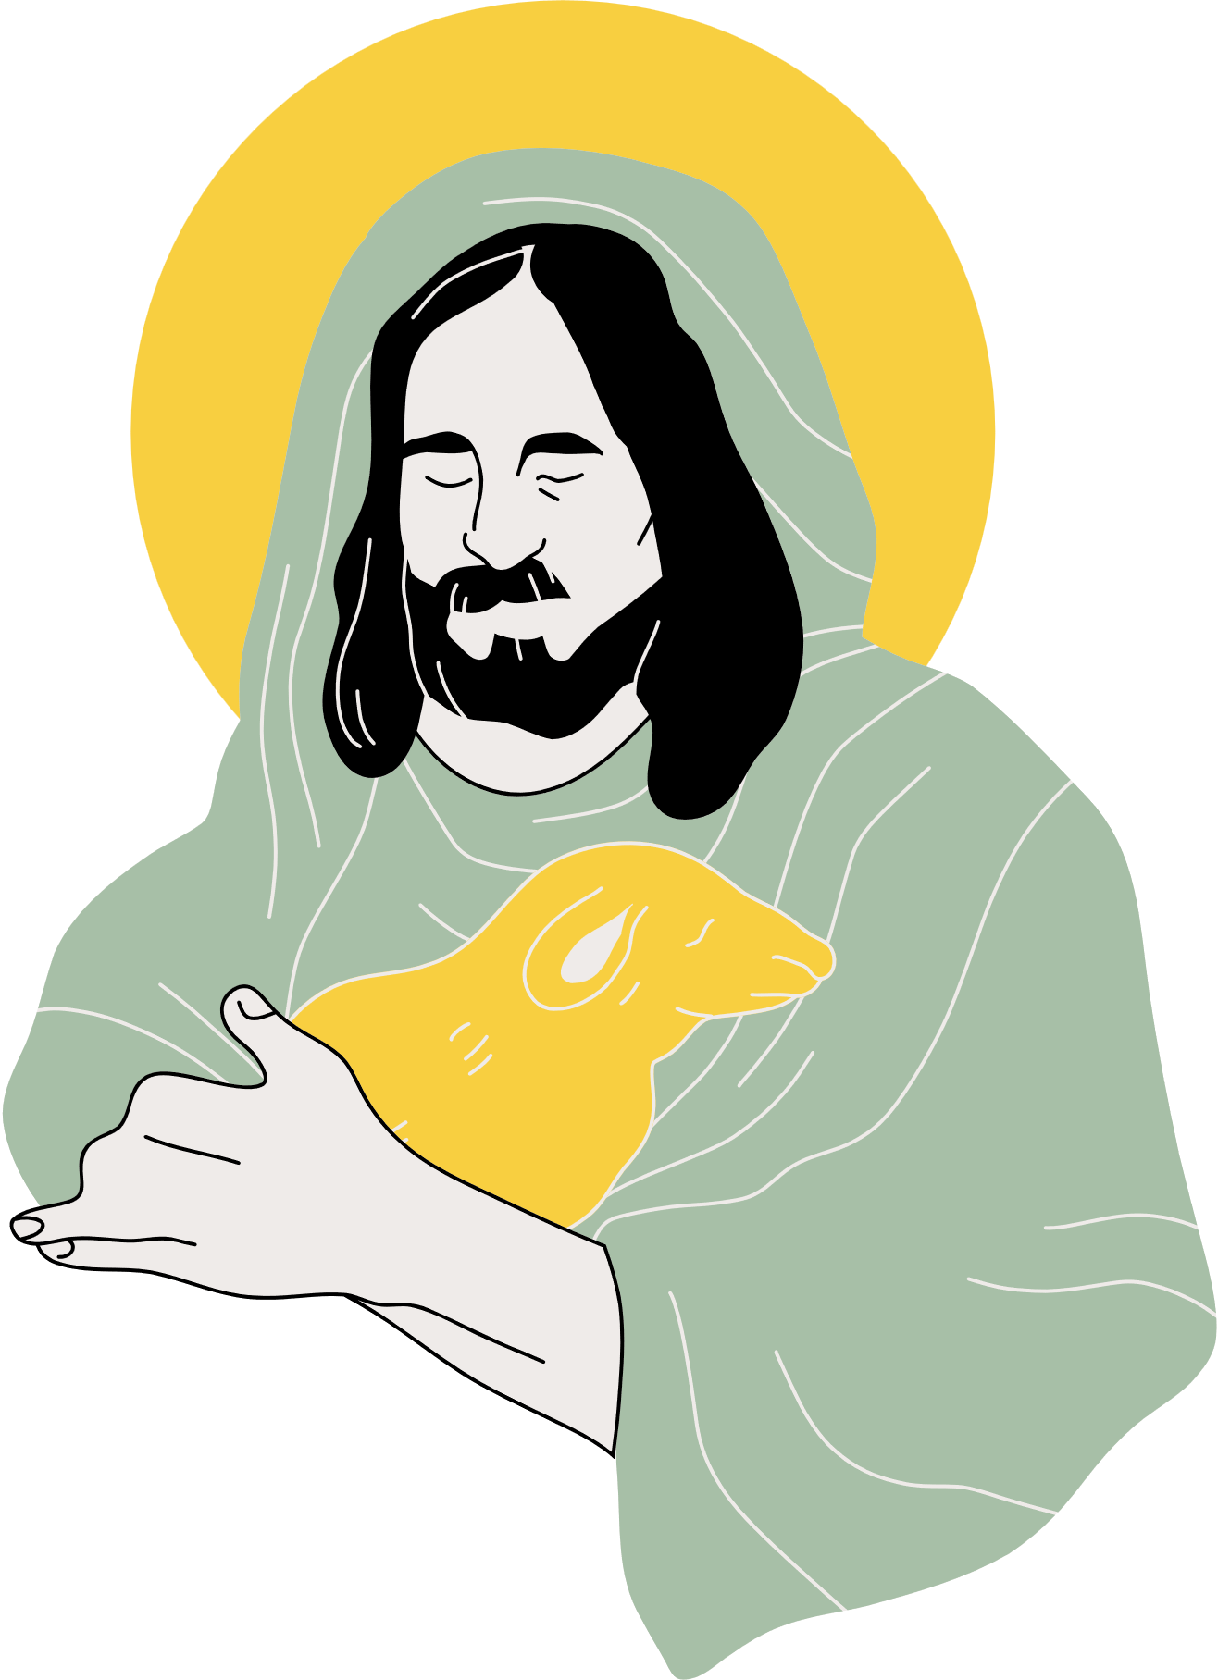
OUR EXAMPLE
Jesus was the epitome of the ultimate model of who lived a life of self-sacrifice, self- renunciation, and for sure- self-surrender.

Slide 14
Allegiance to Jesus (2:9-11)
DEVOTION

Slide 15
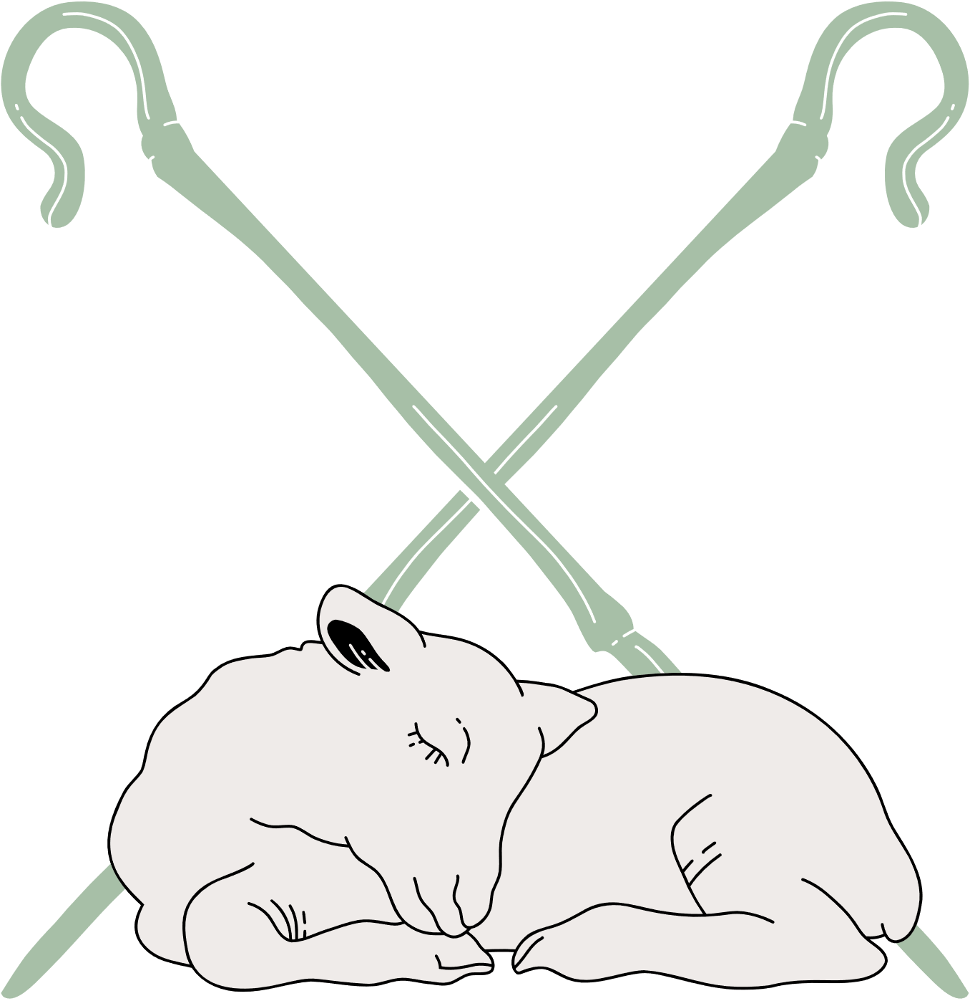
ROLE MODEL
1. The name given to the Resurrected Jesus reveals his inner nature, which was so characteristic of names back in the ancient world, as names back then were more than just a way of distinguishing.
2. The Name Jesus is the supreme Name- Name above all names- because this is who Jesus is in his innermost being.

Slide 16
ROLE MODEL
Everyone will bow down before Jesus and pay him homage one day.
4. Jesus Christ is Lord- the most basic confession of faith on the part of the Church.

Slide 17
CONSIDER
  How can we as members here of the Hillcrest Church Family show more of a humble attitude toward our Elders, our Deacons, our Ministers, and especially to each other?
  What are some practical ways our children can show humility to our leaders, Sunday School Class teachers, Ms. Jenny Putnum, our children’s minister, their parents and their siblings?
  How can we model or instill a habit of humility?

Slide 18
CONCLUSION
Being humble and demonstrating the love of Christ in all we do requires intentionally. As we noted in the lesson, humility is not something taught in our society or educational system. Yet, it is a very important part of the Christian life.

