Slide 1

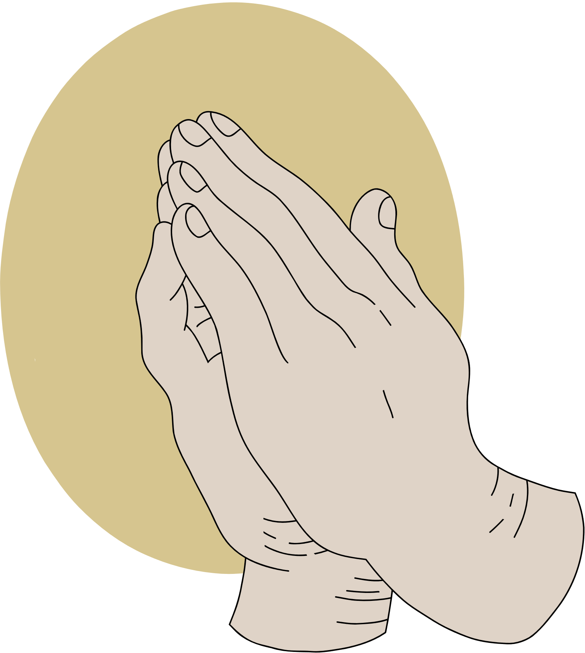
JOY
AMID TRIALS
A study of Philippians

Slide 2
ANNOUNCEMENTS

Slide 3

IMAGINE THIS...

Slide 4

What are trials?
DEFINE

Slide 5



READ ALOUD
to answer: what are trials?
01
02
03
Philippians 1:12-17
James
1:2-4
John
15:18-19

Slide 6

LET’S COMPARE
CHRISTIANITY
Belief | tests of faith, allowed by God to help believers grow spiritually, strengthen their character, and rely on God's grace brings people closer to God leads to maturity and completeness. | Belief | trials (fitnah) are considered a test from Allah various forms—through hardships, wealth, health, or relationships seen as opportunities to purify the soul and draw closer to Allah by remaining steadfast and faithful.
Purpose | Trials are viewed as a means of refining faith, teaching reliance on God, and preparing believers for eternal life. | Purpose | Test, strengthen, cleanse them of sin, and reminder of their dependence on Allah, ultimately leading to greater rewards in the afterlife (Akhirah).
ISLAM

Slide 7
LET’S COMPARE
HINDUISM
BUDDHISM
Belief | trials in life are karma from one’s actions, either in this life or previous ones. part of the cycle of rebirth) The goal is to endure trials with detachment and see them as a path to spiritual progress. | Belief | Trials are a consequence of desire, attachment, and ignorance. By understanding the causes of suffering, one can follow the Eightfold Path to end it. suffering is a fundamental part of existence
Purpose | a way to burn off bad karma, learn important spiritual lessons, and progress toward liberation from the cycle of rebirth. | Purpose | recognize the impermanence of life, eliminate attachments, and achieve nirvana, freeing themselves from the cycle of suffering.

Slide 8



THINK
What makes Christianity unique in its view on suffering?

Slide 9


CHRISTIANITY
Christianity is unique in its understanding of grace - suffering is not a means to become worthy of reward, but a refinement to become more Christlike. The other religions see suffering at a some level of transactional sequence in which I am owed or am more worthy of reward, enlightenment, etc.

Slide 10
How do we know if they’re good or bad?
EXAMINE

Slide 11
READ
Read Philippians 1:18-26 quietly to yourself.

Slide 12
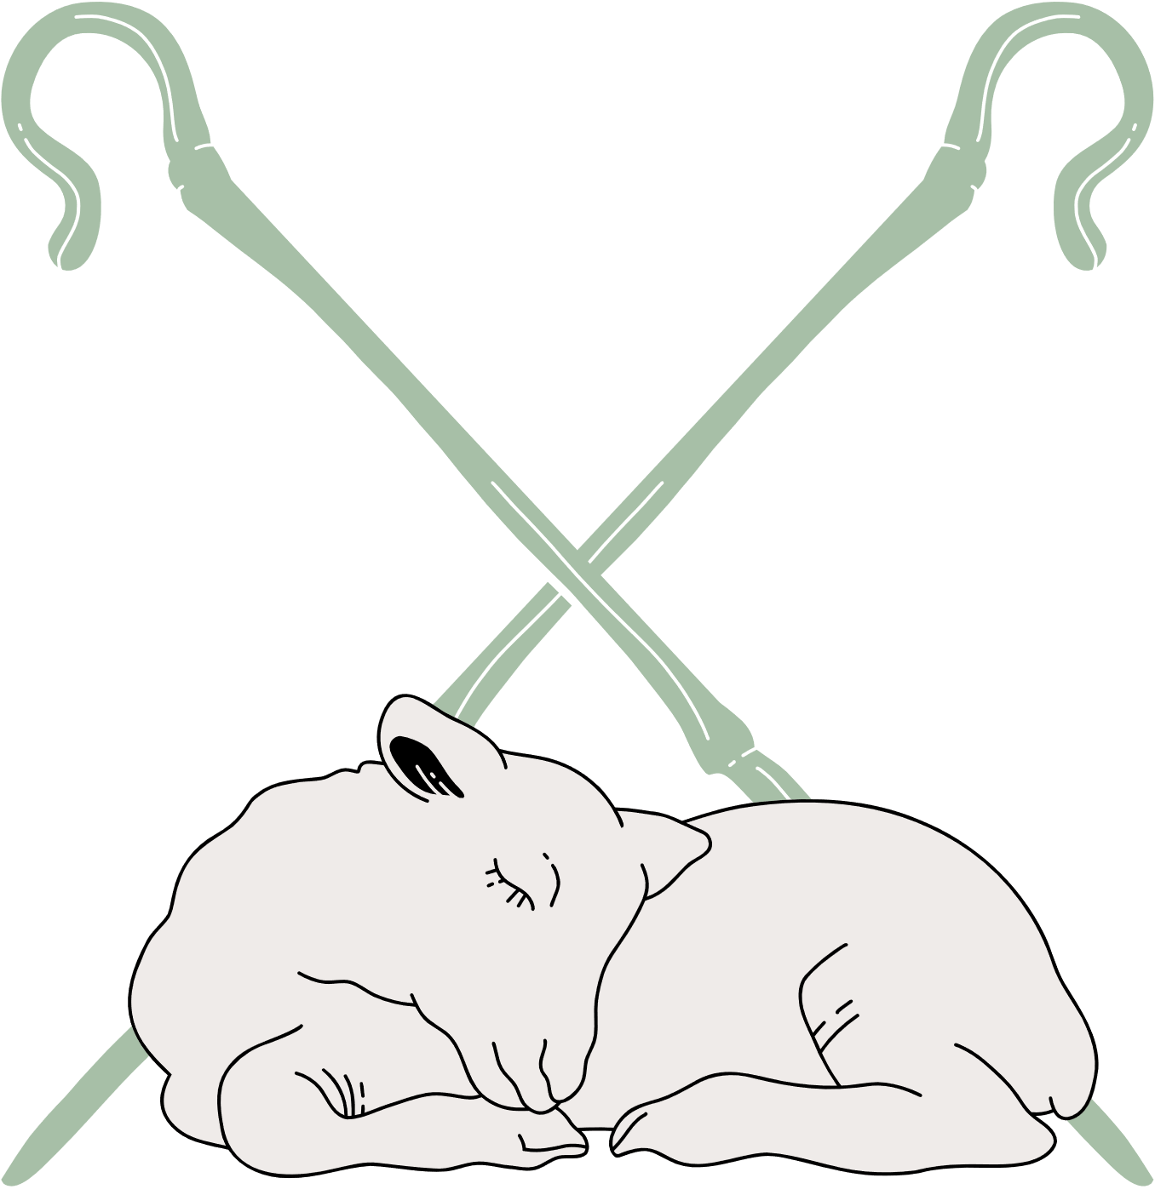
DISCUSS
With the person to your left, briefly discuss the difference between a “good” or “bad” trial.

Slide 13

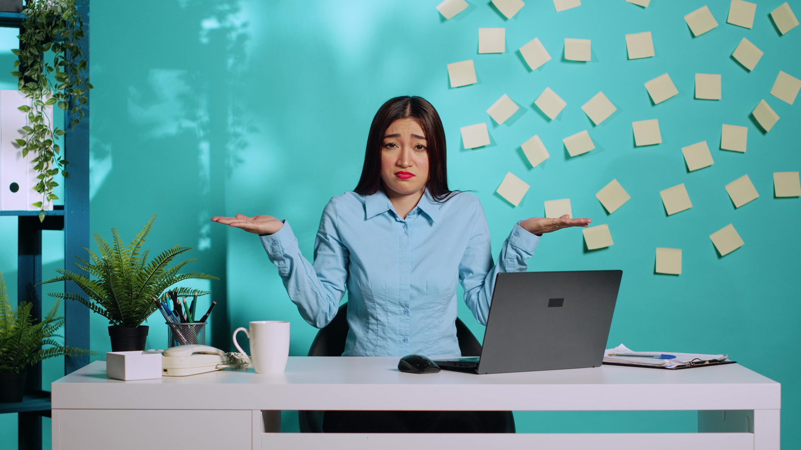
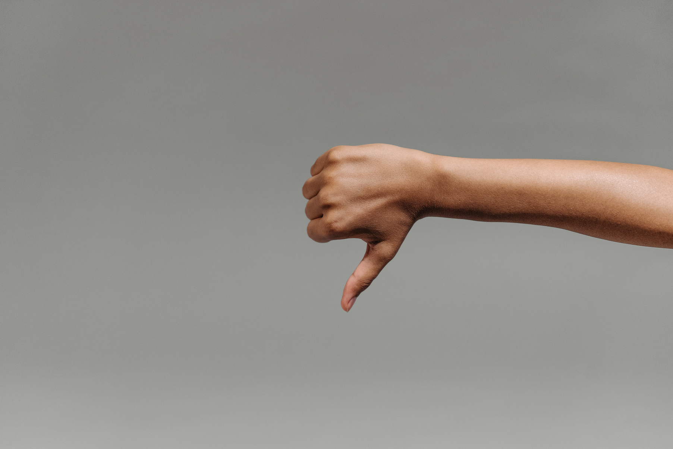
TIME TO VOTE
Good
Both
Bad

Slide 14
QUESTION 1
You lose your job because you refused to follow the morally questionable procedures, in turn causing great financial stress on your family.

Slide 15
QUESTION 2
Your spouse catches you in a lie, which leads to great mistrust and strain on the relationship.

Slide 16
QUESTION 3
You are dealing with a chronic illness that hinders you from going to worship with fellow believers.

Slide 17
QUESTION 4
You are angry with your dear friend for their regrettable choices and lash out and hurt them with your words.

Slide 18

RESULTS?
It's difficult, if not impossible, to discern whether suffering is "good" or "bad". It's not really about good or bad, it's more about our response and how we can turn it into good (testimony).

Slide 19
How can you find the joy/good in the bad?
MINDSET

Slide 20
READ
Leader,
Read Philippians 1:27-30 aloud

Slide 21
ACTIVITY
  groups of 3-5 people.
  Each group will pick one of the scenarios
  One (or two) person(s) will be the voice/defender of the person undergoing trials, and
  the rest at the table will be interviewing them to find the “good” or “bad” in these trials.

Slide 22
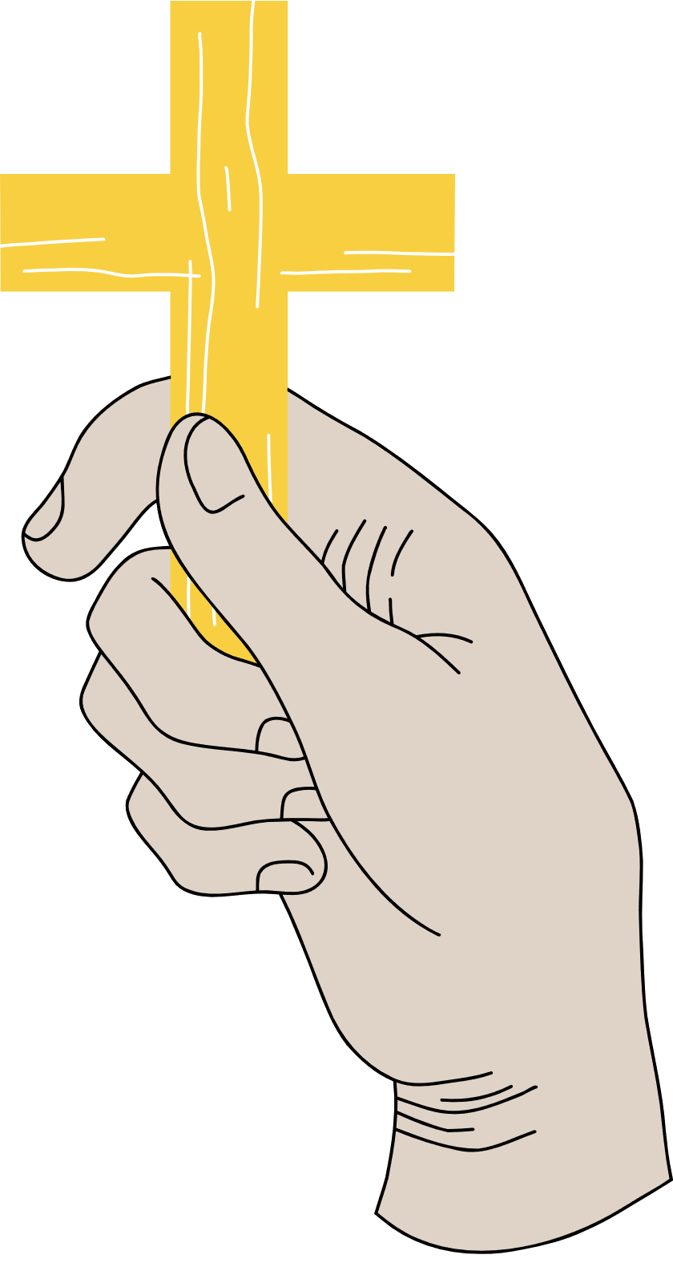
ACTIVITY
How did your person turn their TRIAL into their testimony?
1 | A nomadic, innocent man is arrested for peaceful protest, and after facing an unfair trial is given the death penalty. | 2 | An unemployed, teenage girl has an unplanned pregnancy and is ostracized by the church.
3 | A passionate, aspiring, Christian author has a degenerative eye disease that hinders his ability to write. | 3 | A successful businessman is ridiculed and rejected by his community for his controversial career.

Slide 23

REVEAL
Quietly consider: how did your person turn their TRIAL into their TESTIMONY?

Slide 24
REVEAL
How did your person turn their TRIAL into their testimony?
1 | JESUS | 2 | MARY
3 | PAUL | 3 | MATTHEW

Slide 25
How can you turn your TRIALS into your TESTIMONY?
REFLECT

Slide 26
REFLECT
Silently think of a recent trial in your life and reflect on these questions:
  Based on your earlier discussion, is this a good or bad trial?
  How can you specifically aim to turn your TRIAL into your TESTIMONY?
Write down your revelations and plans for application.

Slide 27
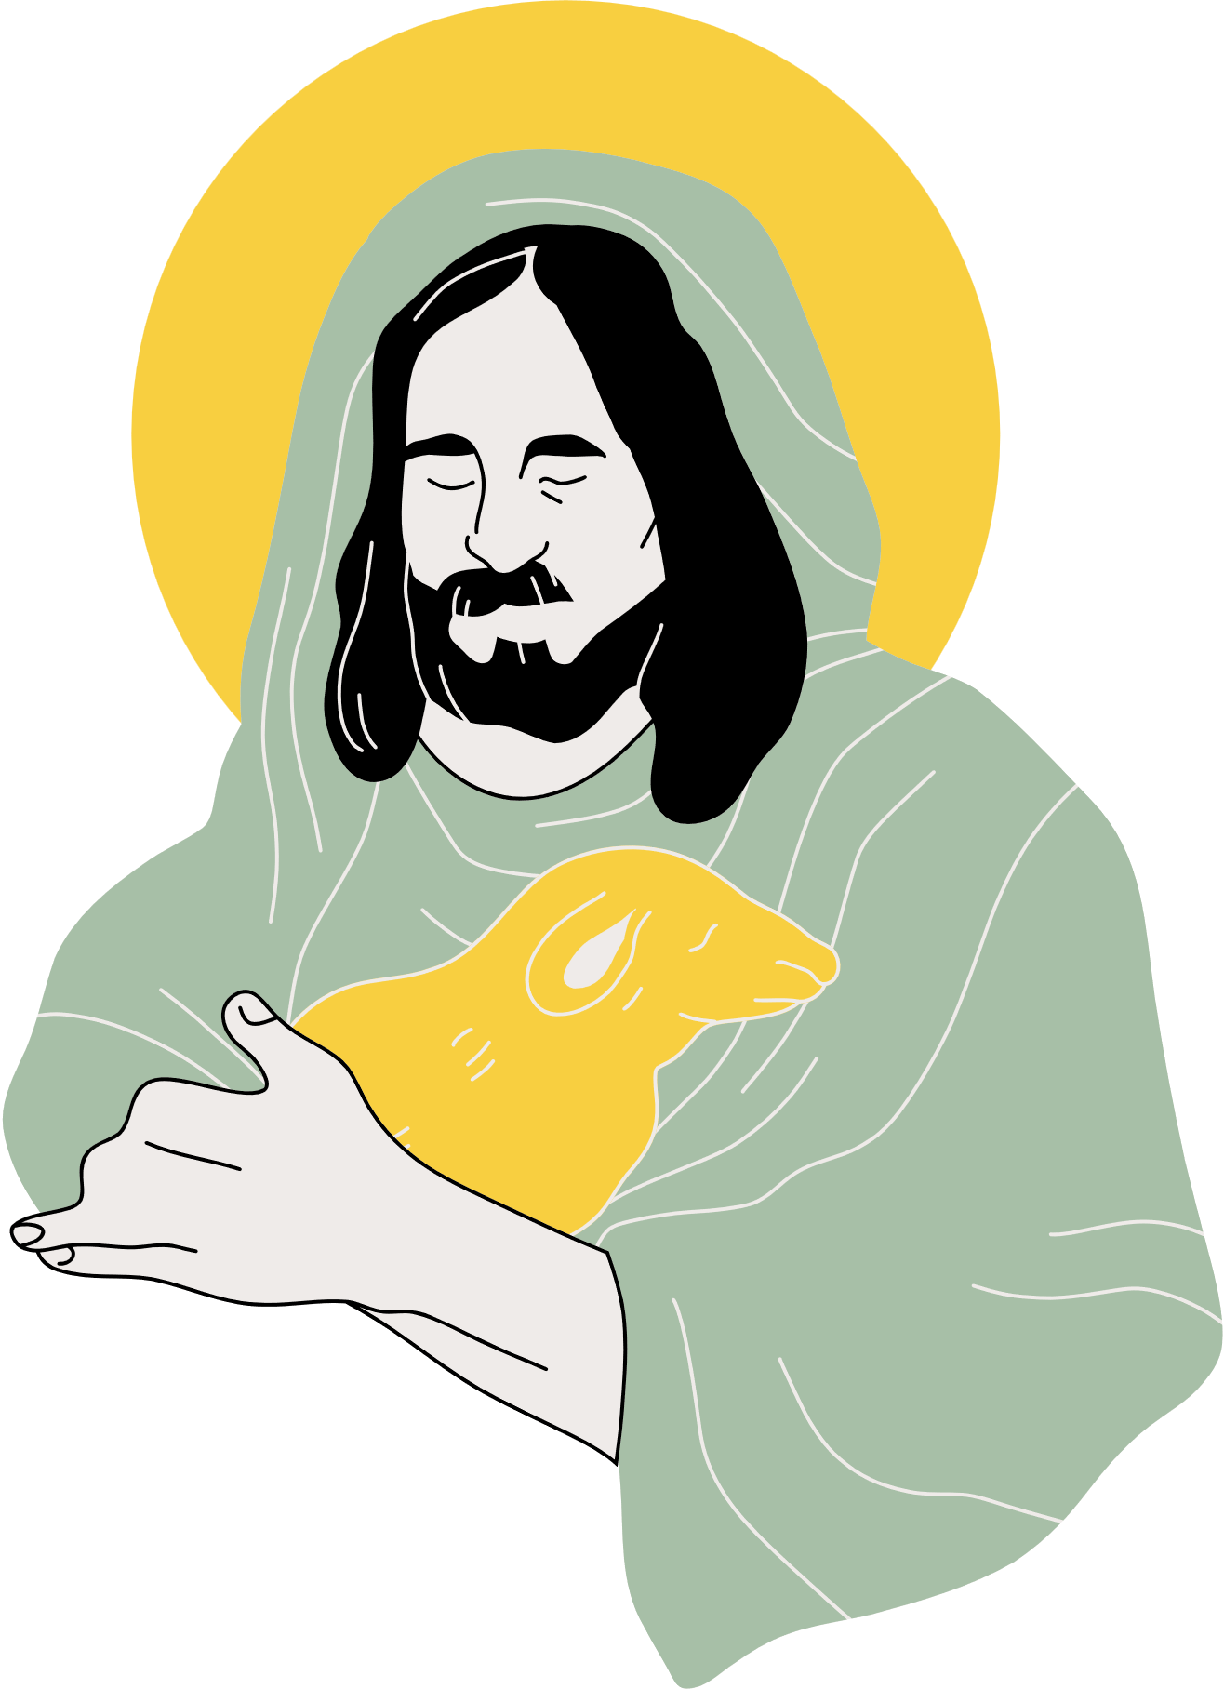
WRAP UP
  Reread Phil. 1:12
  trials are inevitable, and whether they are good or bad, God can use them for your refinement and His glory.
  Next week, we will be examining how humility can aid us in trials as well.

