Slide 1
SESSION 7:
MEETING NEEDS WITHOUT NEEDING MEETINGS

Slide 2
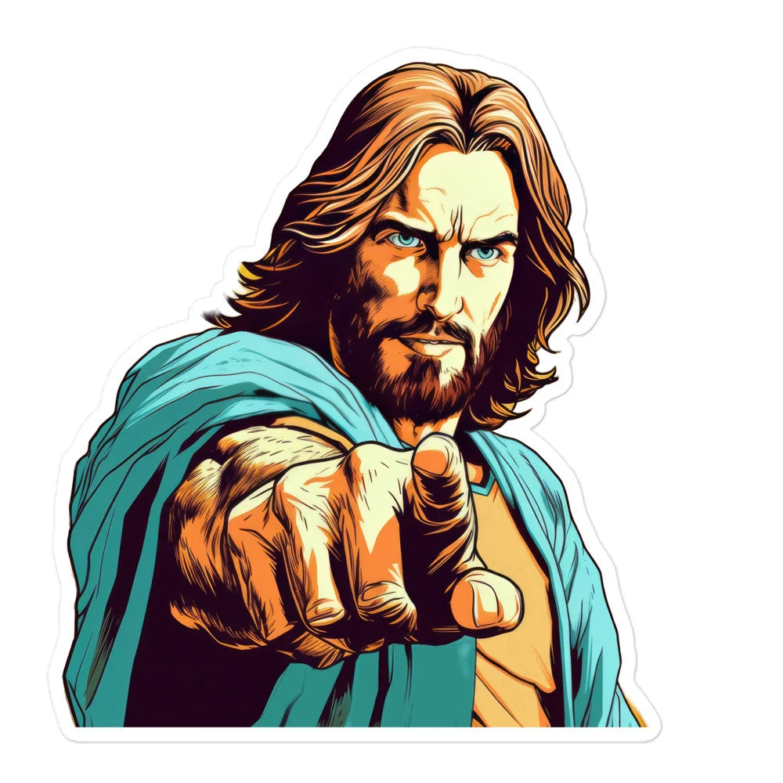
OPENING QUESTION:
How are you going to handle them?
Matthew 14:13-21
Mark 6:30-44
Luke 9:10-17
John 6:1-14

Slide 3
OPENING QUESTION:
How are you going to handle them?
Send them away.
Make a budget?
You do it.
Leave it to a kid…
Pray.
Feed them all, plus…
Etc.

Slide 4
OPENING QUESTION:
How are you going to handle them?
How do we send people away so we don’t have to deal with them?
Are budgets an asset or a problem? How about committees?
Does this story matter today?

Slide 5
How are you going to handle them?
Point 1: Do it Yourself (Mark 2:1-12)
A few days later, when Jesus again entered Capernaum, the people heard that he had come home. 2 They gathered in such large numbers that there was no room left, not even outside the door, and he preached the word to them. 3 Some men came, bringing to him a paralyzed man, carried by four of them. 4 Since they could not get him to Jesus because of the crowd, they made an opening in the roof above Jesus by digging through it and then lowered the mat the man was lying on. 5 When Jesus saw their faith, he said to the paralyzed man, “Son, your sins are forgiven.”
6 Now some teachers of the law were sitting there, thinking to themselves, 7 “Why does this fellow talk like that? He’s blaspheming! Who can forgive sins but God alone?”

Slide 6
How are you going to handle them?
Point 1: Do it Yourself
8 Immediately Jesus knew in his spirit that this was what they were thinking in their hearts, and he said to them, “Why are you thinking these things? 9 Which is easier: to say to this paralyzed man, ‘Your sins are forgiven,’ or to say, ‘Get up, take your mat and walk’? 10 But I want you to know that the Son of Man has authority on earth to forgive sins.” So he said to the man, 11 “I tell you, get up, take your mat and go home.” 12 He got up, took his mat and walked out in full view of them all.
This amazed everyone and they praised God, saying, “We have never seen anything like this!”

Slide 7
How are you going to handle them?
Point 1: Do it Yourself
What obstacles do we encounter when helping the poor?
Where was the benevolence committee?
What does “going thru the roof” look like today?

Slide 8
How are you going to handle them?
Point 2: Sometimes it’s too much. (Acts 6)
In those days when the number of disciples was increasing, the Hellenistic Jews among them complained against the Hebraic Jews because their widows were being overlooked in the daily distribution of food. 2 So the Twelve gathered all the disciples together and said, “It would not be right for us to neglect the ministry of the word of God in order to wait on tables. 3 Brothers and sisters, choose seven men from among you who are known to be full of the Spirit and wisdom. We will turn this responsibility over to them 4 and will give our attention to prayer and the ministry of the word.”
5 This proposal pleased the whole group. They chose Stephen, a man full of faith and of the Holy Spirit; also Philip, Procorus, Nicanor, Timon, Parmenas, and Nicolas from Antioch, a convert to Judaism. 6 They presented these men to the apostles, who prayed and laid their hands on them.
7 So the word of God spread. The number of disciples in Jerusalem increased rapidly, and a large number of priests became obedient to the faith.

Slide 9
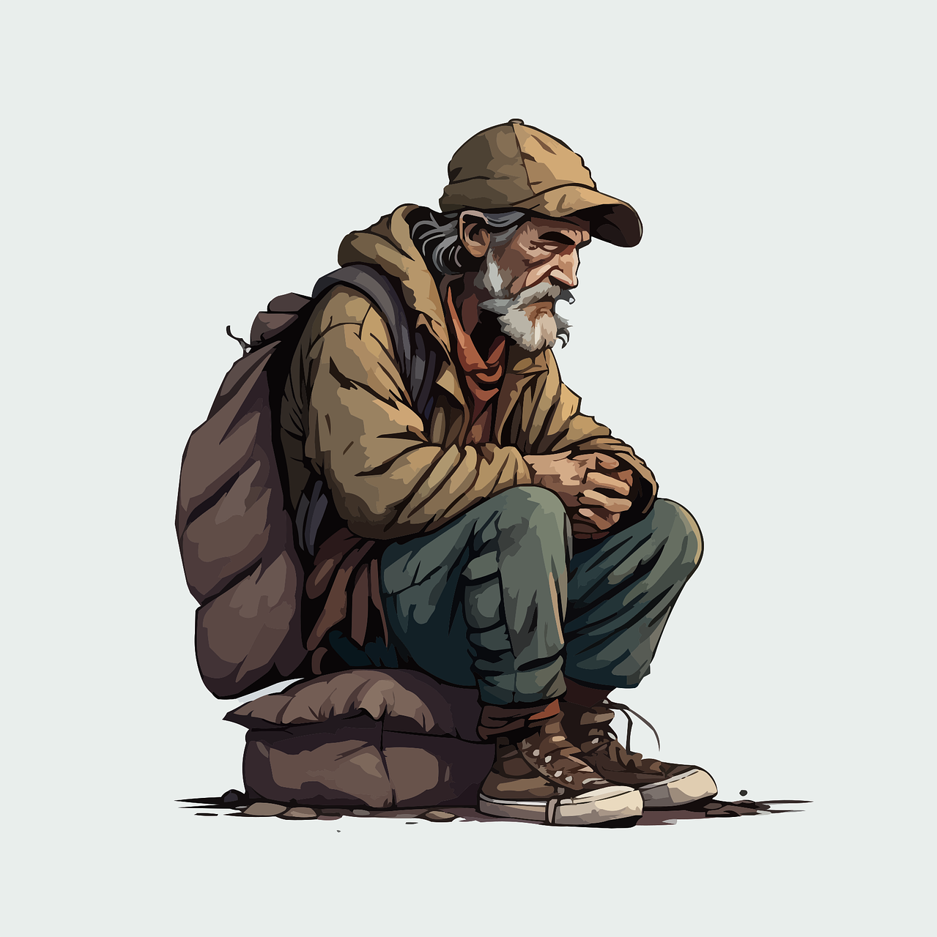
How are you going to handle them?
Point 2: Sometimes it’s too much.
Do you ever need to “hand off” to the elders? Deacons? Why?
When are people’s needs more than we can handle?

Slide 10
How are you going to handle them?
Point 3: What you do about the poor is a reflection of your heart. (1 John 3)
16 This is how we know what love is: Jesus Christ laid down his life for us. And we ought to lay down our lives for our brothers and sisters. 17 If anyone has material possessions and sees a brother or sister in need but has no pity on them, how can the love of God be in that person? 18 Dear children, let us not love with words or speech but with actions and in truth.

Slide 11
CONCLUSION
27 Religion that is pure and undefiled before God the Father is this: to visit orphans and widows in their affliction, and to keep oneself unstained from the world. (James 1:27)
What is the difference between providing financial resources and visiting?
What if our church takes care of widows and orphans? Does that count?

Slide 12
PRACTICAL CONSIDERATIONS
Personal Checklist
Give out Blessing bags (hygiene items, water, etc)
Personal benevolence budget– set your own amount
Daily limits on giving- cap what you give each day
Boundaries– work in pairs, can’t do everything
Refer high need request
Coordinate giving when possible- with Community team
Communicate- let office staff know what is being done
People need you more than your money- build a relationship

