Slide 1
SESSION 6:
UNDERSTANDING AND LIVING IN THEIR CULTURE IS NOT THE SAME

Slide 2
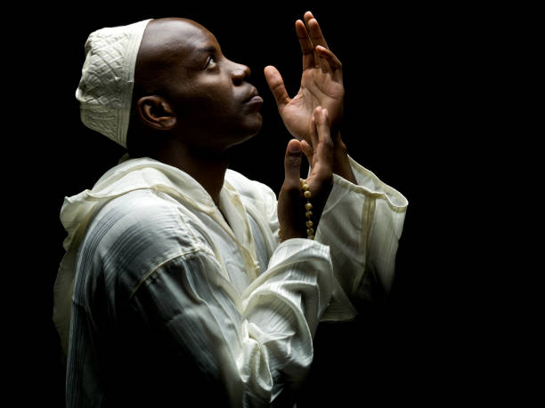
OPENING QUESTION:
What does this verse say about how we should reach the materially poor?
33 “‘When a foreigner resides among you in your land, do not mistreat them. 34 The foreigner residing among you must be treated as your native-born. Love them as yourself, for you were foreigners in Egypt. I am the LORD your God. (Leviticus 19:33-34)

Slide 3
DISCUSSION
If we are going on a trip to ______________(pick a foreign country) what are some things you would want to know before you went?
Some likely responses are:
1. How long you’re staying?
2. How are you going get there?
3. How will you need to get around?
4. How much will stuff cost?
5. What are their culture and customs?
6. What clothes should you pack?

Slide 4
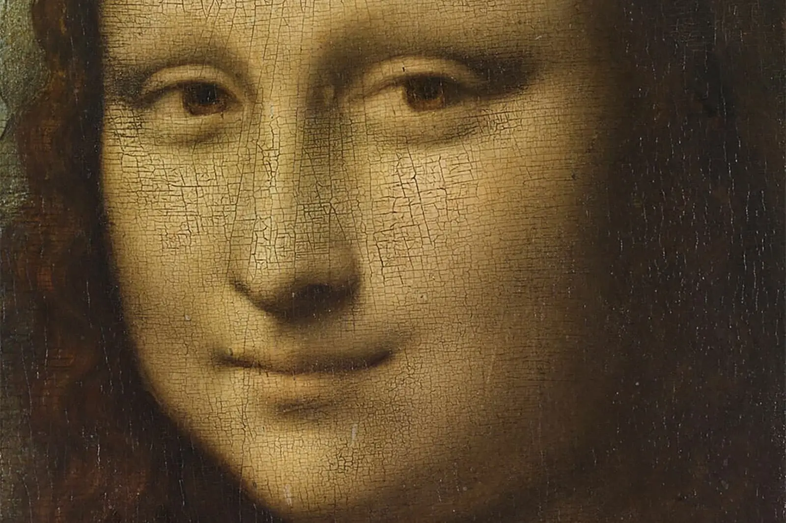
DISCUSSION
Who traveled somewhere and it wasn’t like you thought?
Example: ‘Who has seen the Mona Lisa?”
If you haven’t seen it in person, it likely isn’t what you think.

Slide 5
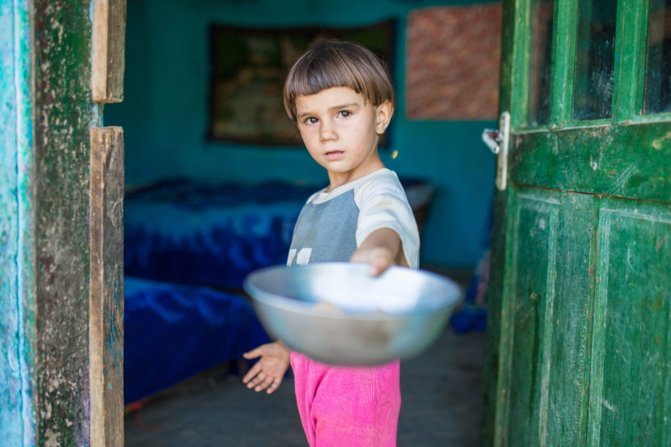
POINT ONE: Poverty isn’t a location, but it can form a different culture.
As discussed earlier it is:
1. Hard to define.
2. Has its own language.
3. Often passed from parents to children.
Today we will talk about the difference in learning about poverty and living it. It can be just as different as reading about France, taking a high-school French class, and then being able to actually live there.

Slide 6
POINT TWO: A quiz to understand living in poverty.
The median savings of a 30-year-old in the United States is ____________?
You wake up and your car won’t start, how do you get to work (or church) using only public transportation?
You have a blowout and need new tires. Can you:
a. Get your car to a tire shop?
b. Afford to pay for the tires?
4. You only have $10 to last a week. Do you:
Buy gas to get to work or groceries for your family?
5. On question number 4, you might have thought or said, “A person in this situation could get food stamps.” What 8 documents do you need to get them?
6. We started out by saying we were planning a trip. Does anyone actually plan to be poor?

Slide 7
POINT TWO: A quiz to understand living in poverty.
Question 1: The median savings level of a 30-year-old in the United States is about $3,200.
a. This is very misleading because almost 50% of ‘young people’ have no savings.
b. Across all age groups, about 20% have no savings.

Slide 8
POINT TWO: A quiz to understand living in poverty.
Question 2: You wake up and your car won’t start, how do you get to work (or church) using only public transportation?
a. Trick Question. There is no public transportation in Abilene on Sunday.
b. If you said I would call someone for a ride, that implies you have a working phone.

Slide 9
POINT TWO: A quiz to understand living in poverty.
Question 3: You have a blowout and need new tires. Can you:
a. Get your car to a tire shop?
b. Afford to pay for the tires?
c. 37% of Americans cannot afford a $400 emergency expense (1 tire)

Slide 10
POINT TWO: A quiz to understand living in poverty.
Question 4. You only have $10 to last a week. Do you:
a. Buy gas to get to work or groceries for your family?
b. People experiencing poverty often have to make decisions we don’t want to make. By the way—if you were ever in this situation, you were experiencing poverty.

Slide 11
POINT TWO: A quiz to understand living in poverty.
Question 5. On question number 4, you might have thought or said, “A person in this situation could get food stamps.” What 8 documents do you need to get them?
a. Identification
b. Proof of US citizenship
c. Proof or residence
d. Proof of income or unemployment status.
e. Proof of medical hardship (if applicable)
f. Proof of household expenses.
g. Proof of disabilities (if applicable)
h. Proof of school attendance (If applicable)
i. And access to a Fax machine, phone, or mail, as well as access to a copier or printer.

Slide 12
POINT TWO: A quiz to understand living in poverty.
Question 6. We started out by saying we were planning a trip. Does anyone actually plan to be poor?
a. Yes.
i. Priests that take vows of poverty. BTW-that isn’t Nathan, Zach, Alan, or Jenni.
ii. People in countries that we consider impoverished—and are often quite satisfied with their culture and lifestyle.
iii. Very rarely—people who choose to live in poverty.
1. Communes
2. People who choose to live in extreme poverty (IE homeless on purpose).
b. Often no. It is the result of:
i. An unplanned situation (IE illness, loss of income, etc)
ii. Not knowing there is anything different (think generational).

Slide 13
FINAL THOUGHT
Poverty isn’t a disease. There isn’t a magic vaccine to make it go away.
But there are ways to:
1. Make it temporary- None of us would go on vacation not planning to come home.
2. Make sure it isn’t fatal. Yes, living in poverty can be deadly. Imagine instead of a tire in question 4 it was heat in the winter or air conditioning when it was 115 in Abilene in August. There are a lot of places where you ‘Don’t drink the water.’
3. Welcome foreigners—sojourners in Abilene living in poverty.

