Slide 1
SESSION 3:
UNDERSTANDING THE LANGUAGE OF POVERTY

Slide 2
OPENING QUESTION:
Have you ever been in a situation where you felt like everyone was speaking a different language? What was that like for you? Were you able to bridge that gap of misunderstanding?

Slide 3
VIDEO: UNDERSTANDING LANGUAGE AND HIDDEN RULES

Slide 4
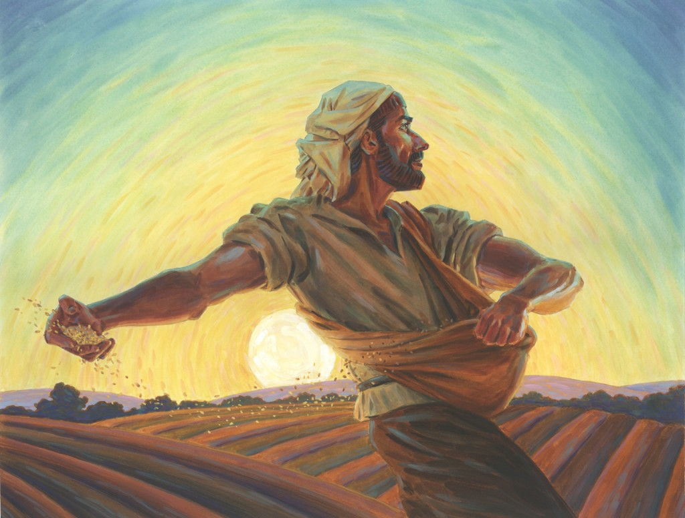
UNDERSTANDING PARABLE LANGUAGE
How were parables a form of language everyone could understand no matter what socioeconomic status they were?

Slide 5
THE WEALTH COMPARISON
19 “There was a rich man who was dressed in purple and fine linen and lived in luxury every day. 20 At his gate was laid a beggar named Lazarus, covered with sores 21 and longing to eat what fell from the rich man’s table. Even the dogs came and licked his sores.
What distinguished the two main characters here?
How do you think the people responded to this story? What was their mindset at the beginning?
Luke 16

Slide 6
THE WORLDLY SEPARATION
22 “The time came when the beggar died and the angels carried him to Abraham’s side. The rich man also died and was buried. 23 In Hades, where he was in torment, he looked up and saw Abraham far away, with Lazarus by his side. 24 So he called to him, ‘Father Abraham, have pity on me and send Lazarus to dip the tip of his finger in water and cool my tongue, because I am in agony in this fire.’
How did this flip the message?
What would the mindset of the people be at this point? How would this connect?
Luke 16

Slide 7
THE WIDE CHASM
25 “But Abraham replied, ‘Son, remember that in your lifetime you received your good things, while Lazarus received bad things, but now he is comforted here and you are in agony. 26 And besides all this, between us and you a great chasm has been set in place, so that those who want to go from here to you cannot, nor can anyone cross over from there to us.’
How does this also describe the chasm between the wealthy and the poor?
Does this chasm exist today in our church? What is our mindset?
Luke 16

Slide 8
THE WORTHLESS CONVERSATION
27 “He answered, ‘Then I beg you, father, send Lazarus to my family, 28 for I have five brothers. Let him warn them, so that they will not also come to this place of torment.’ 29 “Abraham replied, ‘They have Moses and the Prophets; let them listen to them.’ 30 “‘No, father Abraham,’ he said, ‘but if someone from the dead goes to them, they will repent.’
31 “He said to him, ‘If they do not listen to Moses and the Prophets, they will not be convinced even if someone rises from the dead.’”
Does this part seem harsh to the listener?
How does this happen in todays world?
How can we bring grace and truth to those who will not listen?
Luke 16

Slide 9
FINAL THOUGHTS ON POVERTY
How did Jesus use this story to connect to the materially poor of his audience? How can we do the same thing in our conversations with those who struggle financially?

Slide 10
CLOSER
Discuss ways we can better learn how to communicate with those in poverty, knowing a different approach is needed. How can just handing out money be a bad thing? Why is communication and relationship building more important to the process of helping?

Slide 11
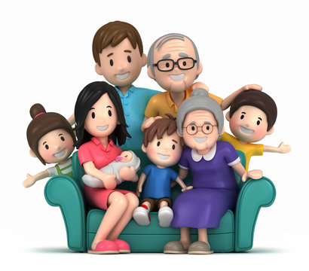
FOR THE ROAD
As a family, what are some things we can do to put ourselves in situations to help and have conversations with those in poverty? Brainstorm ways you can talk more with people in poverty (safety first, always) so we can better understand the thought process.

