Slide 1
SESSION 2:
THE VIEW OF SCRIPTURE ON THE POOR

Slide 2
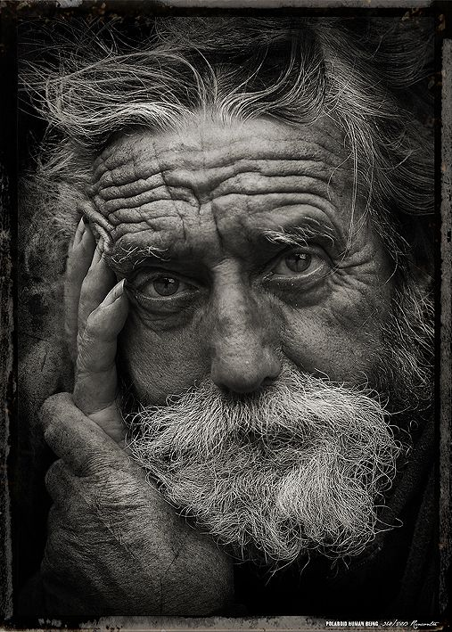
OPENING QUESTION:
What does it mean to be “poor in the eyes of the world” according to James 2:5? Are we not all poor in that sense?
Listen, my dear brothers and sisters: Has not God chosen those who are poor in the eyes of the world to be rich in faith and to inherit the kingdom he promised those who love him? (James 2:5, NIV)

Slide 3
READ THESE VERSES TOGETHER
Deut. 10:18
Deut. 15:7-8, 11
Isaiah 58:6-7
Galatians 2:10
Romans 12:13
James 1:27, 2:5
What do these scriptures say about our responsibility to the poor among us?

Slide 4
OT: It is DEFENSIVE on God’s part.
He defends the cause of the fatherless and the widow…
How does God defend the cause of the poor?

Slide 5
OT: It is OFFENSIVE on our part.
I command you to be openhanded toward your brothers and toward the poor and needy...
What does it mean to be “open handed?”

Slide 6
OT: It is EXTENSIVE on the world’s part.
Is it not to share your food with the hungry and to provide the poor wanderer with shelter – when you see the naked, to clothe them…
Why do you believe there is so much poverty in the world?

Slide 7
NT: OUR ATTITUDE: What are our choices?
We should be eager to help the poor.
Read and discuss how we should have the mindset of Christ (attitude) from Philippians 2:1-11.

Slide 8
NT: OUR ATTRIBUTES: What is our mindset?
The poor are chosen by God for His Kingdom.
Read and discuss what our mindset towards the poor should be from Ephesians 1:3-10. Compare with Philippians 2:1-11.

Slide 9
NT: OUR ATTENTION: Where is our time?
Pure and faultless religion is looking after the poor.
Why does he mention looking after the poor before he mentions being unstained by the world?
Read and discuss what real religion is according to Galatians 2:19-21.

Slide 10
CLOSING
After seeing how concerned God is in His Word for the poor, what are ways we can each individually show that same grace and truth to those in poverty? What about as a church?

Slide 11
For the road
What are some ways you as a family can become more active in helping the poor? Brainstorm ways you could have a family service project, or visit the local Christian Service Center, Love and Care Ministries or other nonprofits for ideas.
Check in with our own ministries, as well, like our Community Team or Hillcrest Helps, for specific ways you can serve in our church or community.

