Slide 1
Hillcrest Church of Christ | Spring 2023
JAMES
FAITH IN
ACTION
Lesson 10: Faith in Action is charitable with resources

Slide 2
James in a Box
Come now, you rich people, weep and howl for your miseries which are coming upon you. Your riches have rotted and your garments have become motheaten. Your gold and your silver have corroded, and their corrosion will serve as a testimony against you and will consume your flesh like fire. It is in the last days that you have stored up your treasure! Behold, the pay of the laborers who mowed your fields,
JAMES 5:1-6

Slide 3
James in a Box
and which has been withheld by you, cries out against you; and the outcry of those who did the harvesting has reached the ears of the Lord of armies. You have lived for pleasure on the earth and lived luxuriously; you have fattened your hearts in a day of slaughter. You have condemned and put to death the righteous person; he offers you no resistance.
JAMES 5:1-6

Slide 4
It's not the money, it's the greed
What do the "greedy rich" look like?
Hoarding which leads to miseries. (5:1-3)
Injustice for withholding due wages. (5:4)
Self-deception because the arrogant believe they are quite secure, when, in fact they are about to be slaughtered. (5:5)

Slide 5
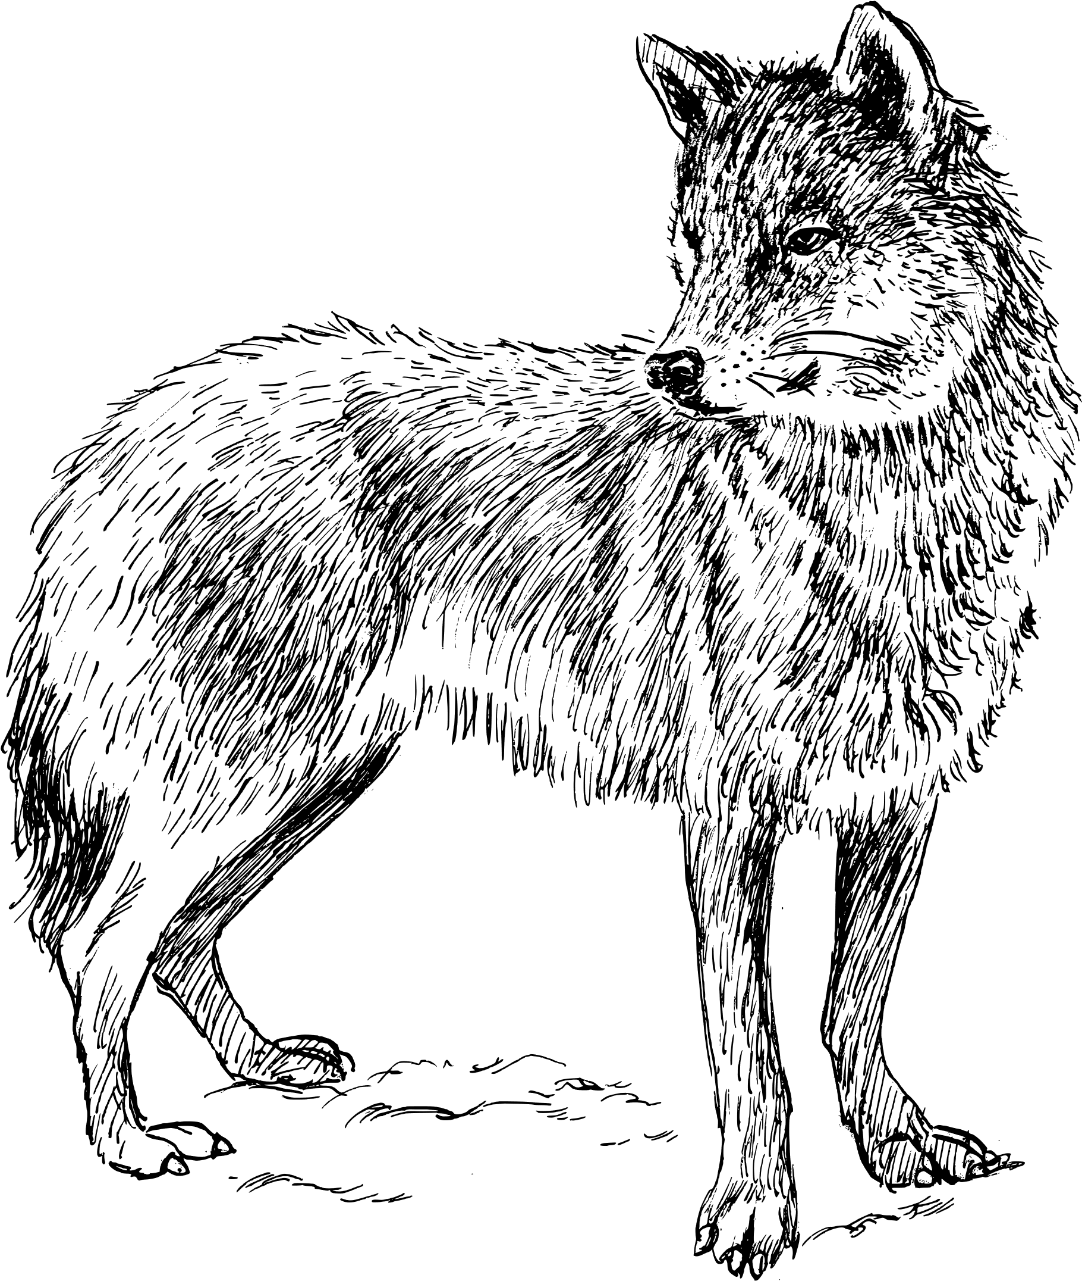
Rich imagery and harsh language describe the greedy rich
Why weeping and howling? (5:1)

Slide 6
Rich imagery and harsh language describe the greedy rich
Imagery of the moth flits from Jesus (Matthew 6:19) to James (5:2)

Slide 7
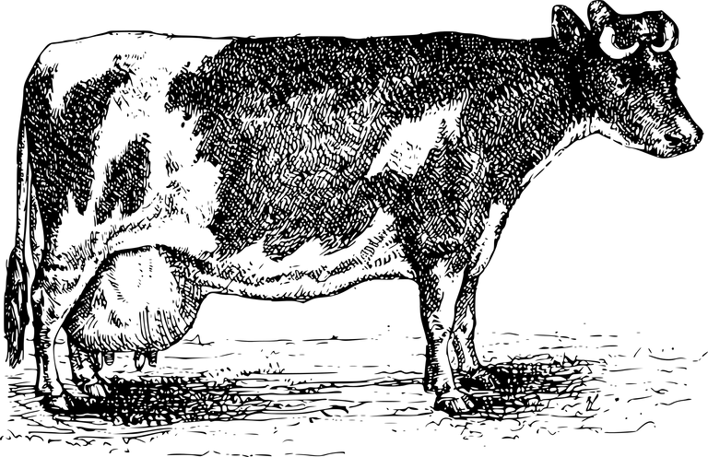
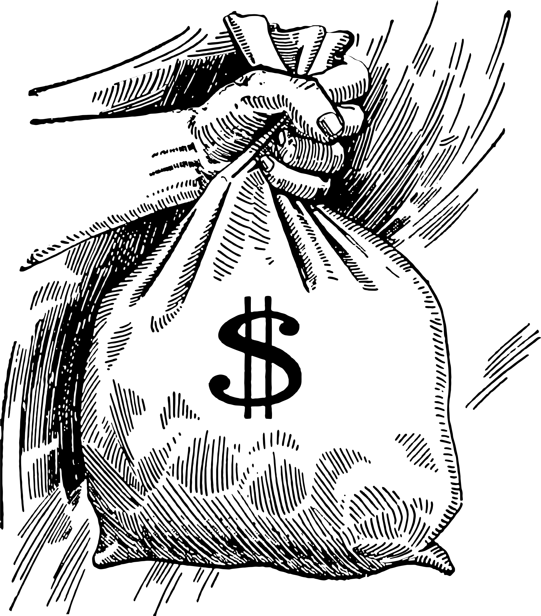
Rich imagery and harsh language describe the greedy rich
Personification paint a word picture of the horror of greed-gained wealth. (5:3,5)

Slide 8
Resources are not just money
Although James addresses the Resources of "you rich," can rich be described in other ways?

Slide 9
Resources are not just money
Although James addresses the Resources of "you rich," can rich be described in other ways?
Time - Every person has the same amount given to us by God each day.
Influence - What a resource this can be when used wisely!

Slide 10
Resources are not just money
The parable of the talents in Matthew 25:14-30 reflects that Jesus expects us to USE all our resources wisely, GAINING more…so that we can DO more.

Slide 11
Discussion Questions
Who were these rich that James is addressing in Chapter 5?
Why does James reprimand the “greedy rich” to weep and howl?
Is there a difference between the “greedy rich” and rich? What does James tell the rich to glory in? (See 1:9-11)
Can a poor man be rich? (See 2:5) What does James mean in this verse?

Slide 12
Discussion Questions
5.Do I use my money in a charitable, non-greedy way? To whom does my
money actually belong?
6.What resources do I have in addition to money?
7.How can I plan this next week to use my resources in a charitable way for
Jesus?
8.James calls the rich to view wealth through the viewpoint of eternity. How
might we steward our wealth differently with this in mind?

Slide 13
JAMES
FAITH IN
ACTION
Hillcrest Church of Christ | Spring 2023

