Slide 1
Hillcrest Church of Christ | Spring 2023
JAMES
FAITH IN
ACTION
Lesson 6: Faith in Action is mindful of the tongue

Slide 2
James in a Box
Let not many of you become teachers, my brethren, knowing that as such we shall incur a stricter judgment. For we all stumble in many ways. If anyone does not stumble in what he says, he is a perfect man, able to bridle the whole body as well. Now if we put bits into the horses’ mouths so that they may obey us, we direct their entire body as well.
Behold, the ships also, though they are so great and
JAMES 3:1-12

Slide 3
James in a Box
are driven by strong winds, are still directed by a very small rudder, wherever the inclination of the pilot desires. So also the tongue is a small part of the body, and yet it boasts of great things. Behold, how great a forest is set aflame by such a small fire! And the tongue is a fire, the very world of iniquity; the tongue is set among our members as that which defiles the entire body,
JAMES 3:1-12

Slide 4
James in a Box
and sets on fire the course of our life, and is set on fire by hell. For every species of beasts and birds, of reptiles and creatures of the sea, is tamed, and has been tamed by the human race. But no one can tame the tongue; it is a restless evil and full of deadly poison. With it we bless our Lord and Father; and with it we curse men, who have been made in the likeness of God; from the same mouth come
JAMES 3:1-12

Slide 5
James in a Box
both blessing and cursing. My brethren, these things ought not to be this way. Does a fountain send out from the same opening both fresh and bitter water? Can a fig tree, my brethren, produce olives, or a vine produce figs? Neither can salt water produce fresh.
JAMES 3:1-12

Slide 6
Teaching is serious business
Was James seeking to discourage people from teaching?

Slide 7
Teaching is serious business
There are dangers in teaching! James warns of "stricter judgment" (greater condemnation).

Slide 8
Teaching is serious business
How might teachers be especially tested or prone to sin in what they say?

Slide 9
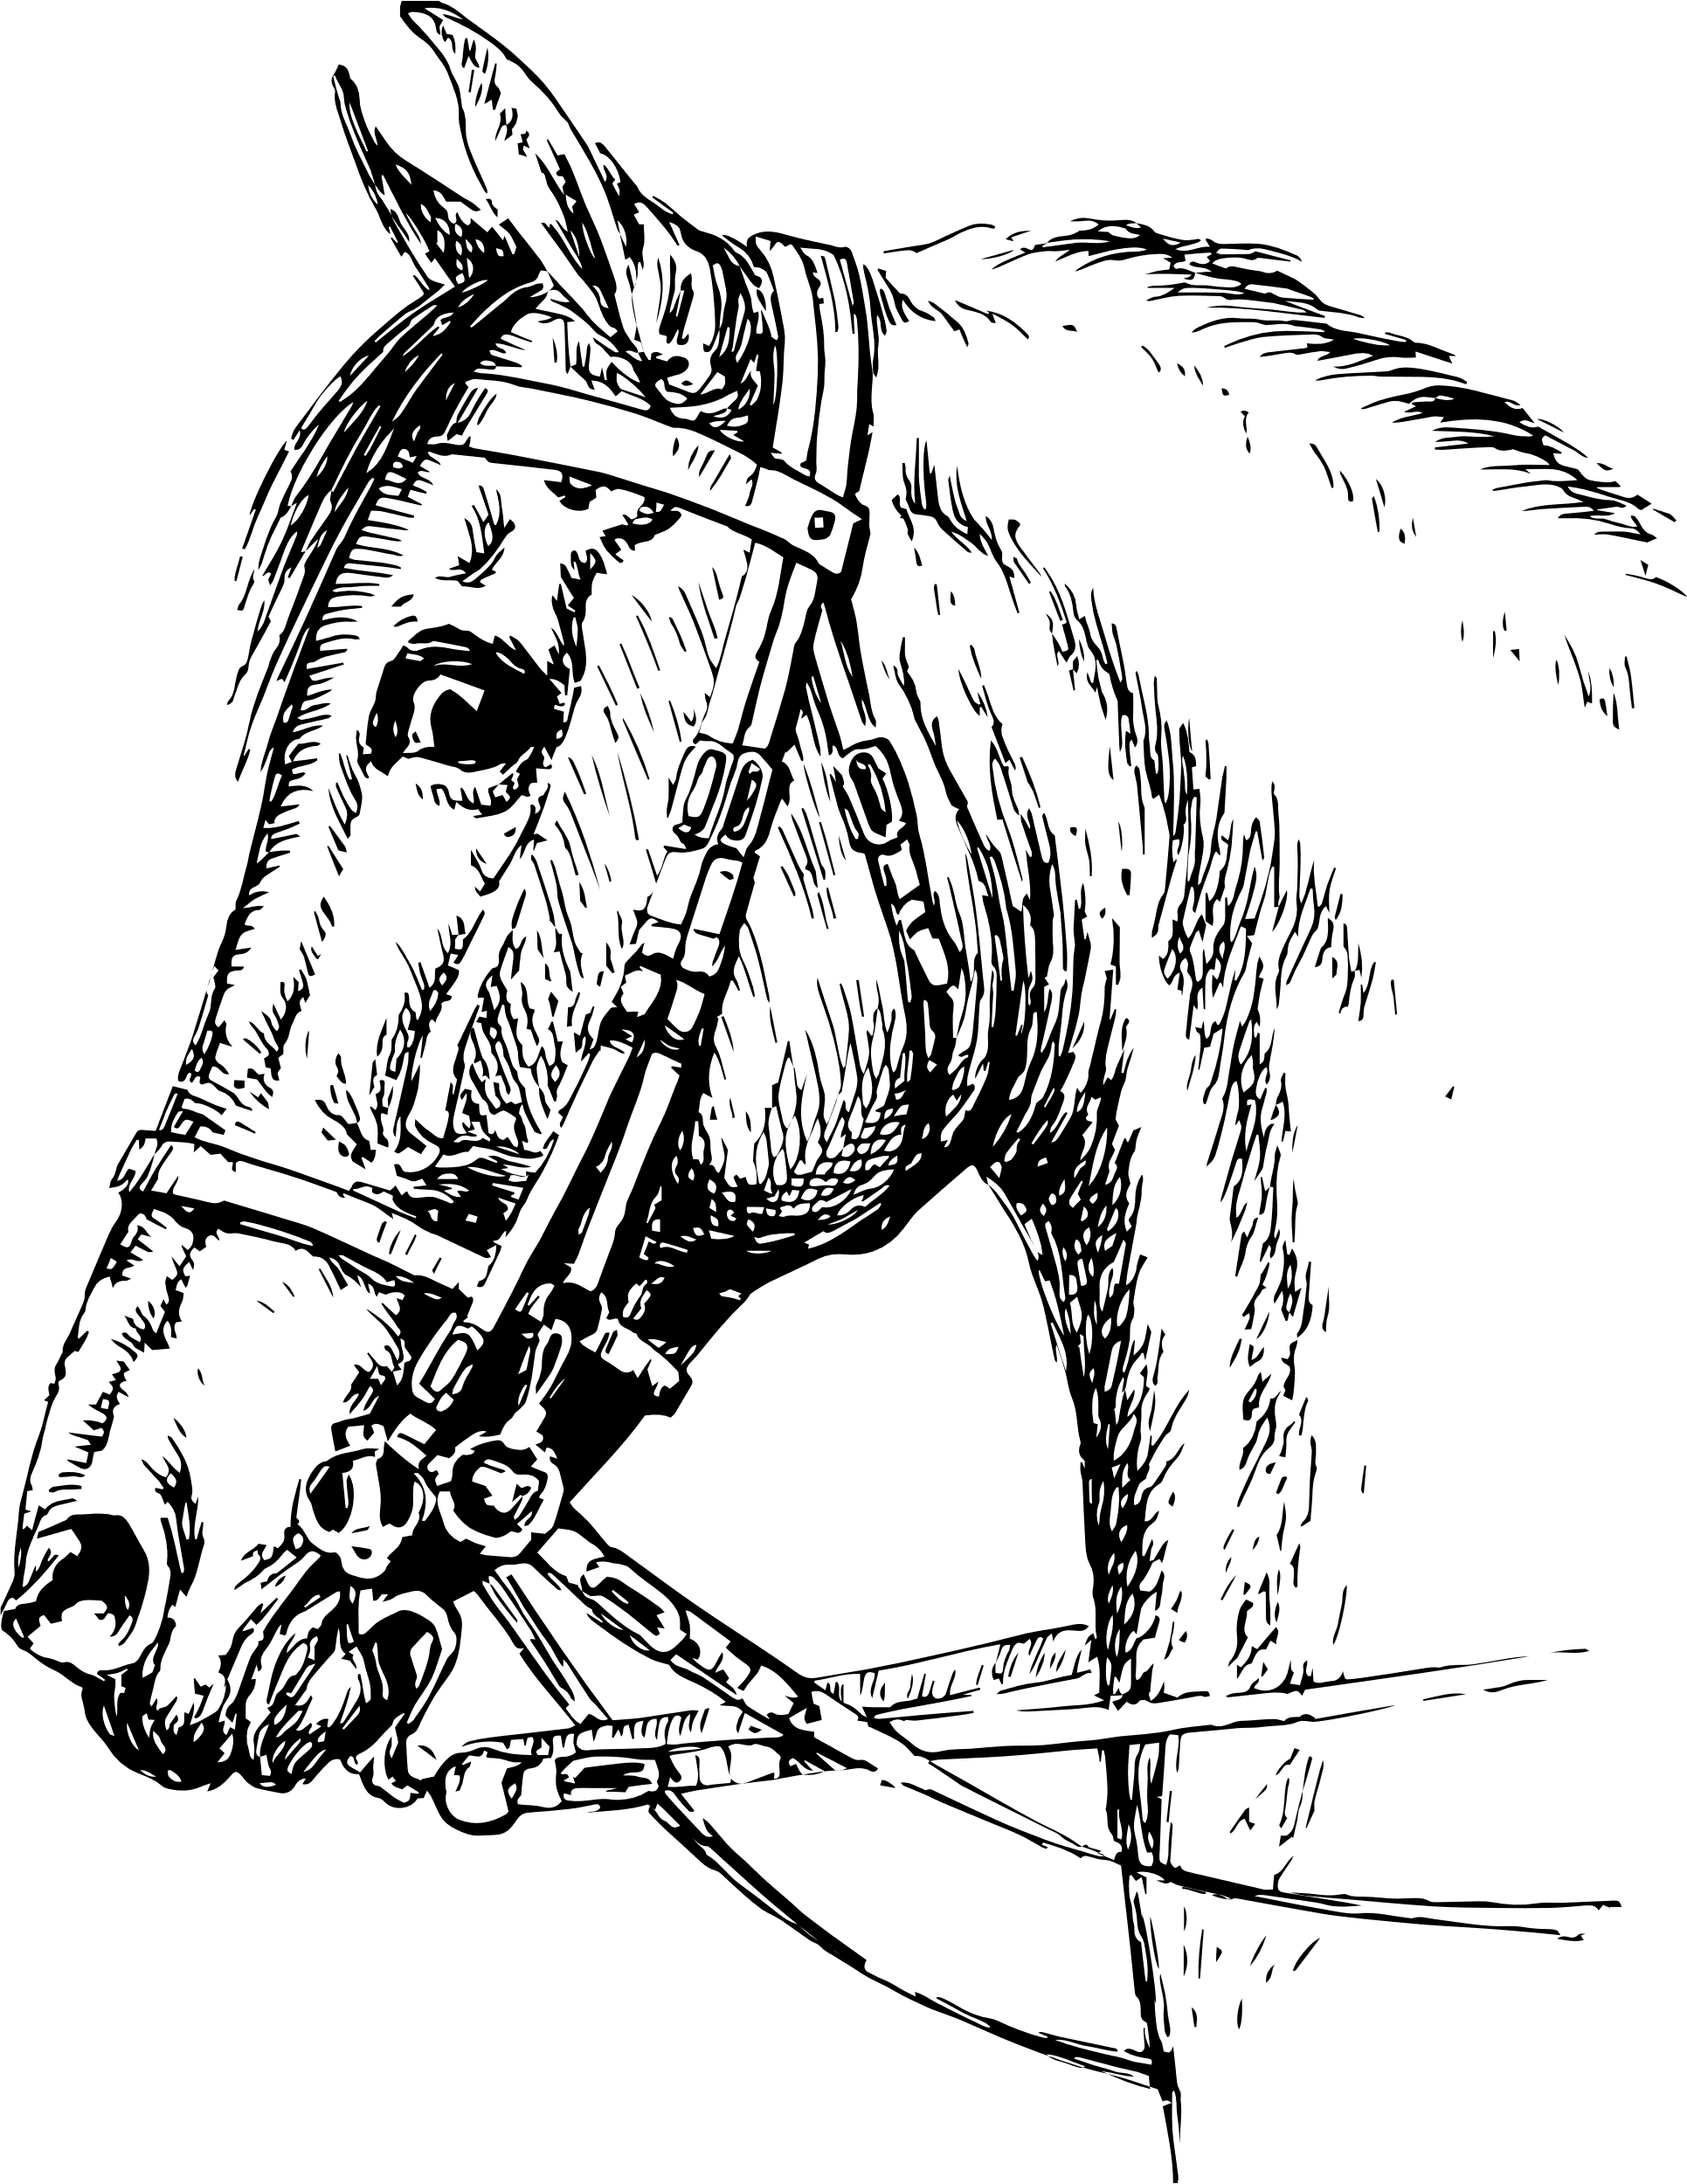
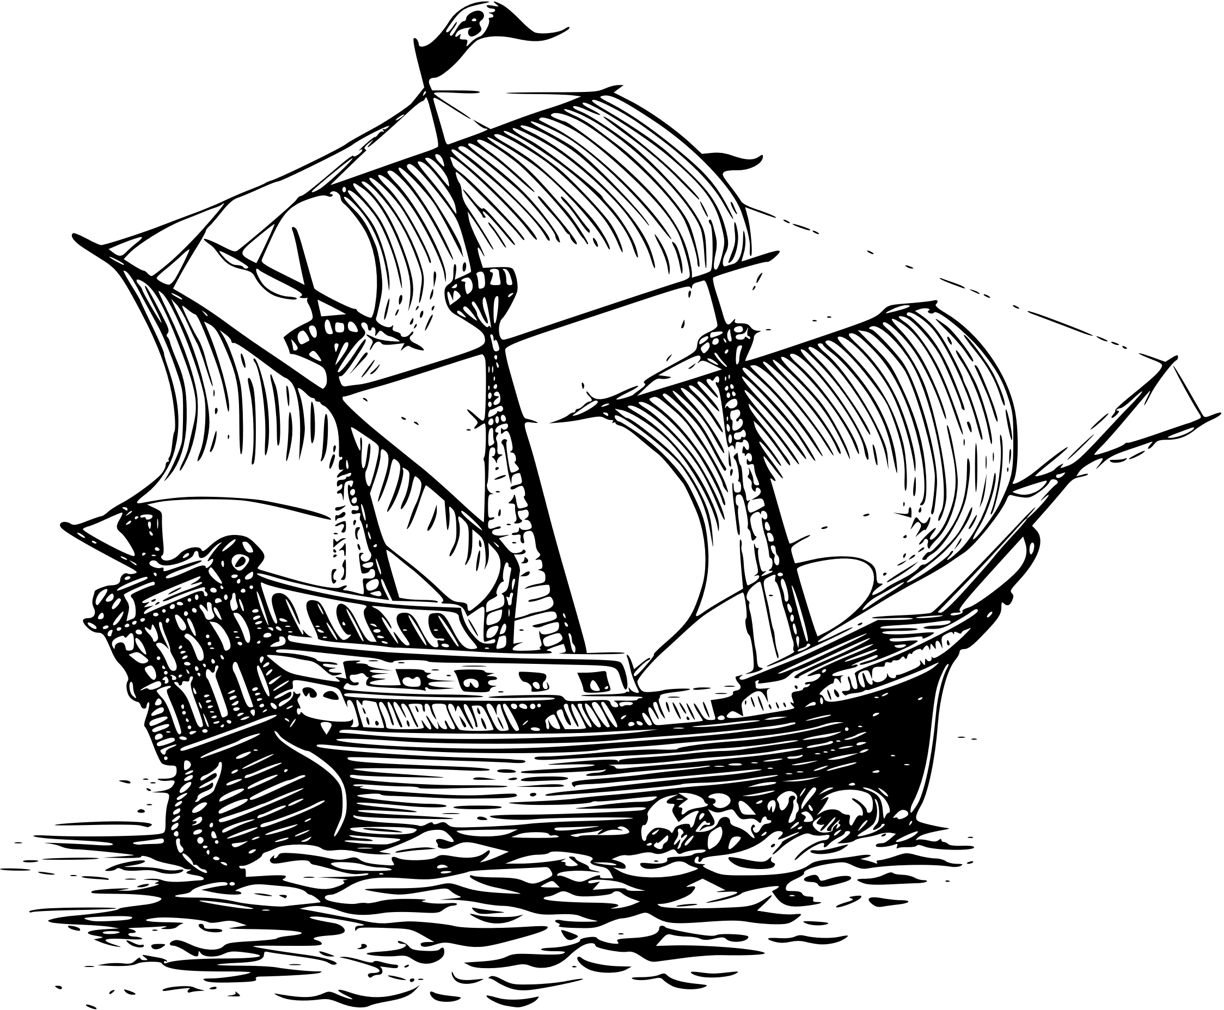
The tongue has great power
The tongue has the power to direct. 3:3-4

Slide 10
The tongue has great power
What example have you experienced or seen where the tongue helped direct
someone or a group
in a powerful way?

Slide 11
The tongue has great power
The tongue has the power to destroy. 3:5-8
James speaks of 7 defiling sins of the tongue:
Blaspheming
Boasting
Cursing others
Quarreling
Speaking against others
Complaining
Swearing

Slide 12
The tongue has great power
What example have you experienced or seen where the tongue
destroyed someone or a
group in a powerful way?

Slide 13
The tongue has great power
"Death and life are in the power of the tongue. And those who love
it will eat its fruit."
Proverbs 18:21

Slide 14
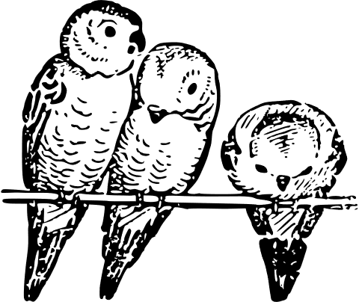
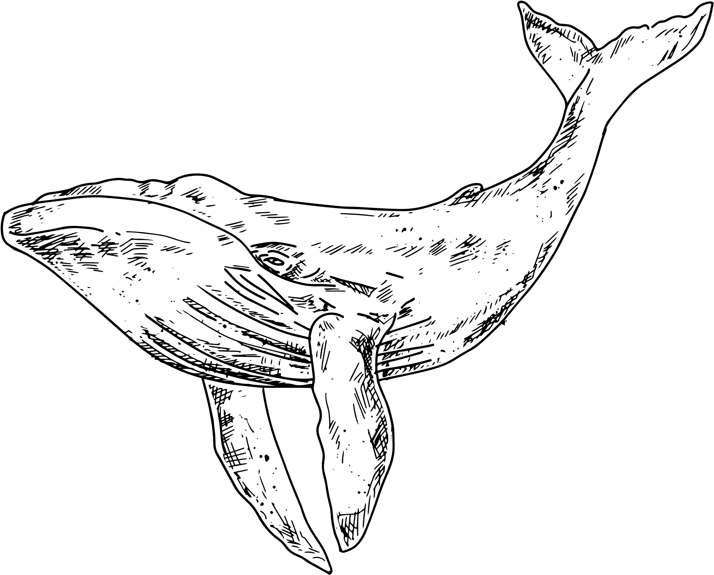
The tongue has great power
No one can tame the tongue. 8a
Wild animals have been tamed
by mankind. However, man's
tongue is yet to be tamed{damazo}

Slide 15
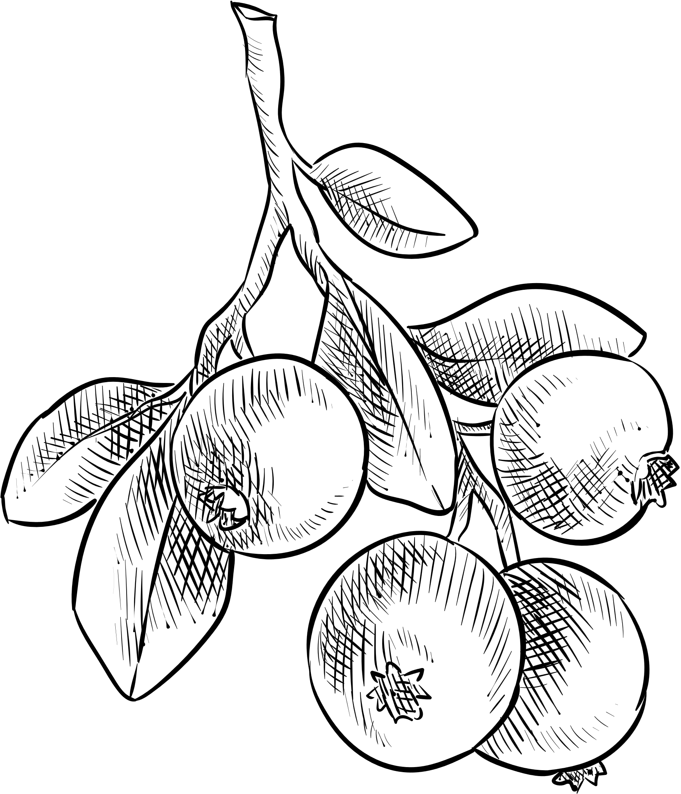
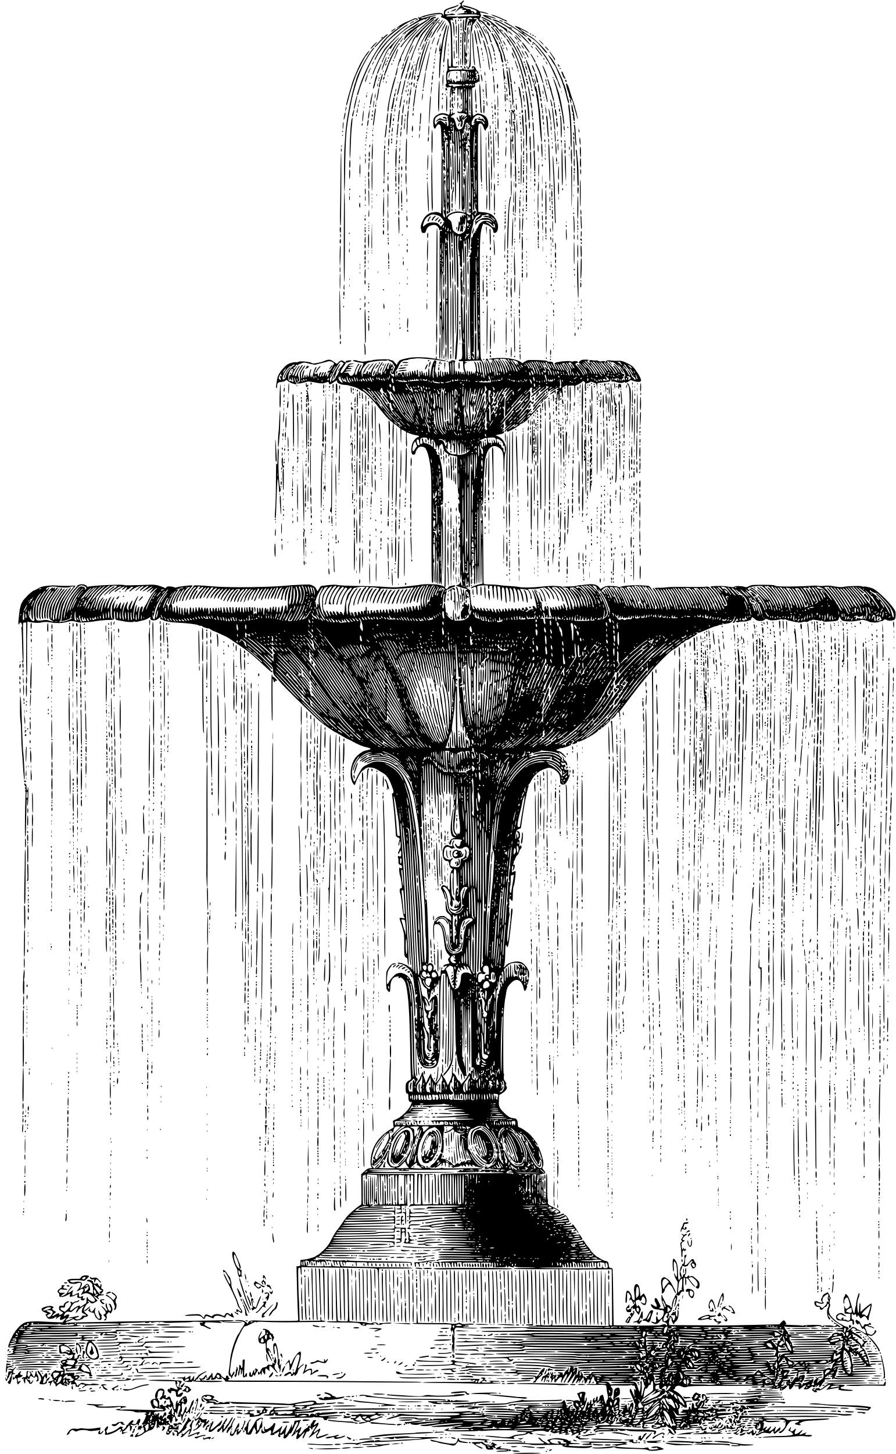
The tongue may be used
in opposing ways
To reach the goal of sinning
less with the tongue,
see that the heart is full
with good. Matthew 12:34-37

Slide 16
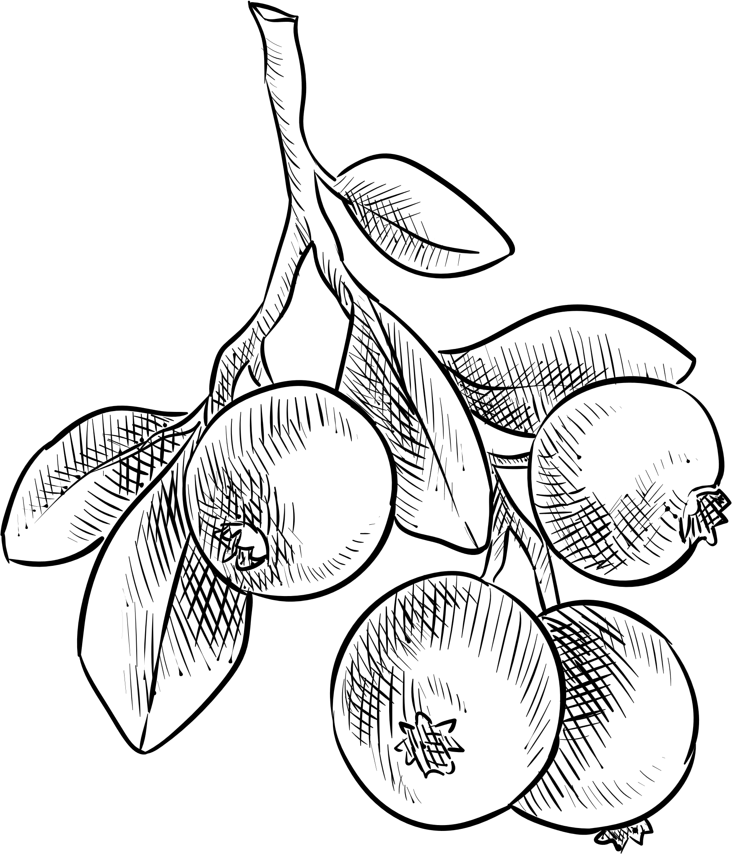
The tongue may be used
in opposing ways
"The words of a man's mouth are
deep waters; The fountain of wisdom is a bubbling brook."
Proverbs 18:4

Slide 17
Discussion Questions
What are some ways in which we all teach?
How much time or attention do you give to your speech?
How is your speech either Christ-like or a hazard to your spiritual walk of faith?
Compare and/or contrast and comment: “If anyone does not stumble in what he says, he is a perfect man, able to bridle the whole body as well.” 3:2; “... no one can tame the tongue.” 3:8

Slide 18
Discussion Questions
5. What blocks or interferes with our taming the tongue? What hinders you
personally?
6. In what way do you consider the tongue “...a restless evil and full of deadly
poison?”
7. Complete the following for yourself: With my tongue,
I ought to ____________!

Slide 19
JAMES
FAITH IN
ACTION
Hillcrest Church of Christ | Spring 2023

